Slide 1
A 39,000 Subexposures/s CMOS Image Sensor with Dual-tap Coded-exposure Data-memory Pixel for Adaptive Single-shot Computational Imaging
Rahul Gulve*¹, Navid Sarhangnejad*¹, Gairik Dutta¹, Motasem Sakr¹, Don Nguyen¹,
Roberto Rangel¹, Wenzheng Chen¹, Zhengfan Xia¹, Mian Wei², Nikita Gusev¹,
Esther Y. H. Lin², Xiaonong Sun¹, Leo Hanxu¹,Nikola Katic¹, Ameer Abdelhadi¹,
Andreas Moshovos¹, Kiriakos N. Kutulakos², Roman Genov¹
¹ Dept. of ECE, ² Dept. of CS, University of Toronto
SCENE-ADAPTIVE HDR
OPTIMAL STRUCTURED LIGHT
ADC1 READOUT
ADC2 READOUT
RECONSTRUCTED HDR
TAP1
TAP2
DISPARITY (1/depth)
Notes:
Hi everyone,
Thank you for tuning into this talk.
Today I present our work on
the adaptive coded-exposure-pixel cameras
for single-shot computational imaging.
As conventional image-capturing hardware is hitting the physical limits,
the computational imaging discipline
is developing techniques to squeeze more and more information from the scene
by clever hardware and software design. [CLICK]

Slide 2
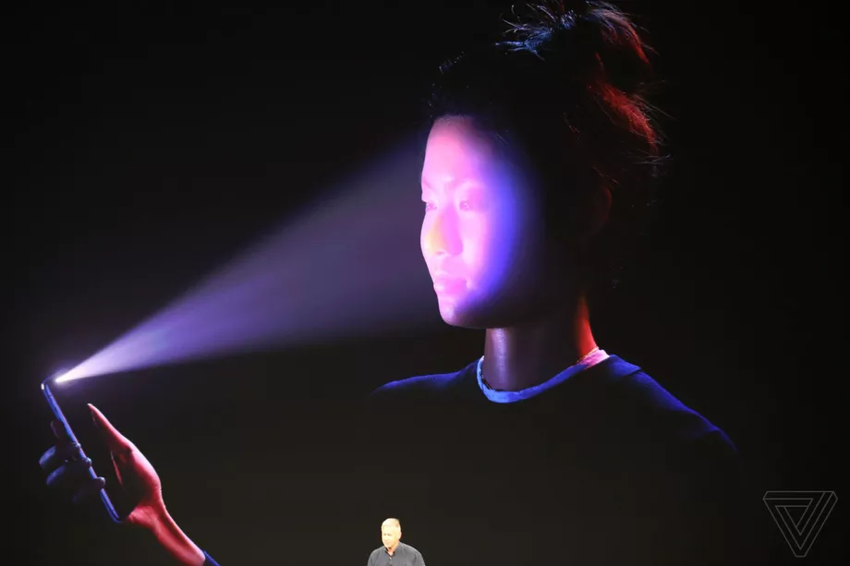
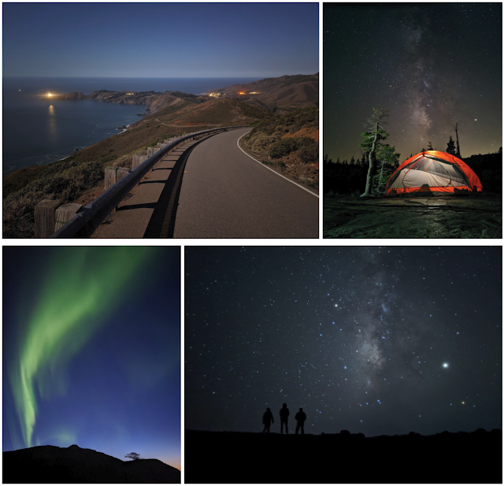
Computational Imaging Applications
HDR IMAGING
FACE ID, APPLE
AUTOPILOT, TESLA
BLACKHOLE IMAGE, EHT
ASTRO-PHOTOGRAPHY, GOOGLE
Notes:
Some of the well know applications in this field are
HDR imaging,
Astro-photography or Night-sight by Google,
Face-ID tech. in iphones,
Machine vision for autonomous driving,
And
Even the image of the blackhole

Slide 3
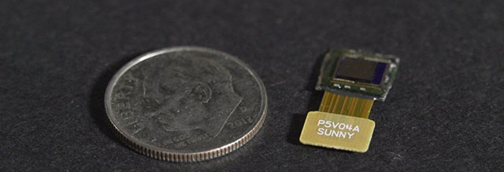
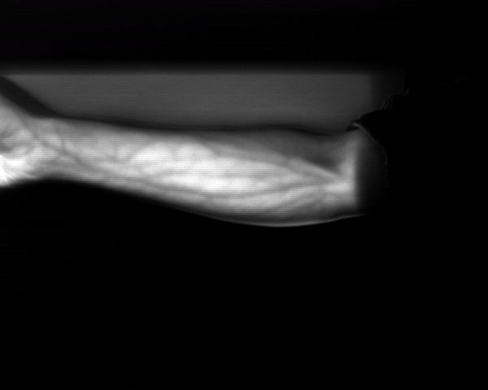
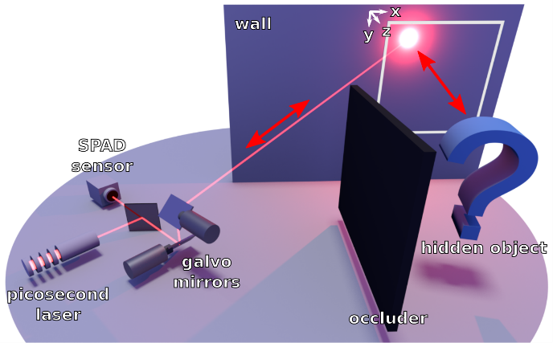
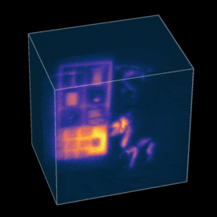
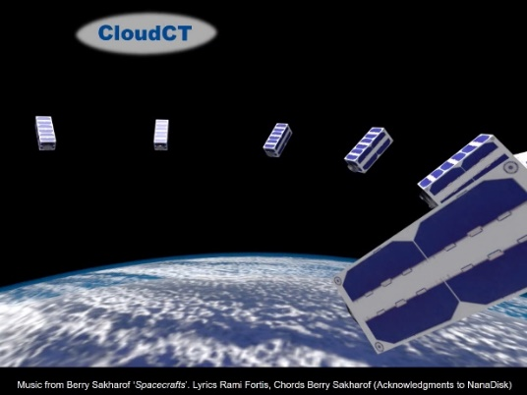
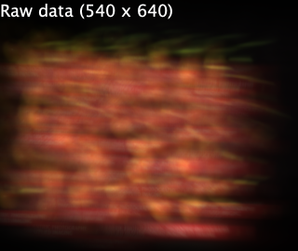
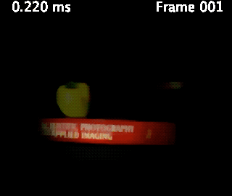
Computational Imaging Applications
HDR IMAGING
FACE ID, APPLE
AUTOPILOT, TESLA
BLACKHOLE IMAGE, EHT
FLATCAM, RICE
NLOS IMAGING, STANFORD/CMU
VEIN IMAGING, CMU
ASTRO-PHOTOGRAPHY, GOOGLE
COMPRESSED SENSING, UCB
CLOUD IMAGING, CLOUDCT
Notes:
There are other computational imaging applications which might be less well-know but developing at very fast rate
such as
- Lenseless camera systems from RICE university (which may allow us to say goodbye to that big camera bump on smart phones)
- Tomography scans of clouds using satellite from CLOUDCT
- High frame rate video extraction from a single frame from UC Berkley,
- A system for vein imaging from CMU
- And Non-line of sight imaging to see around the corners from Stanford and CMU

Slide 4
Computational Imaging Applications
HDR IMAGING
FACE ID, APPLE
AUTOPILOT, TESLA
Behind the scene
HDR IMAGING
FACE ID
SELF DRIVING CARS
HDR IMAGING
FACE ID, APPLE
LIDARS, VELODYNE
https://commons.wikimedia.org/wiki/File:HDRI_Sample_Scene_Window.jpg
Source: Apple
https://www.tesla.com/en_CA/autopilot
Notes:
All of this is possible because of different techniques in computational imaging.
Here I show a small subset of it.

Slide 5
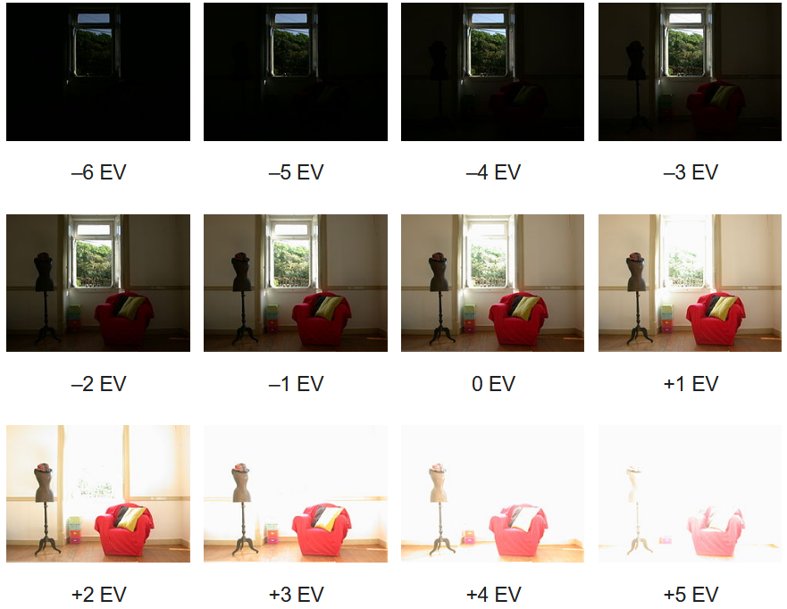
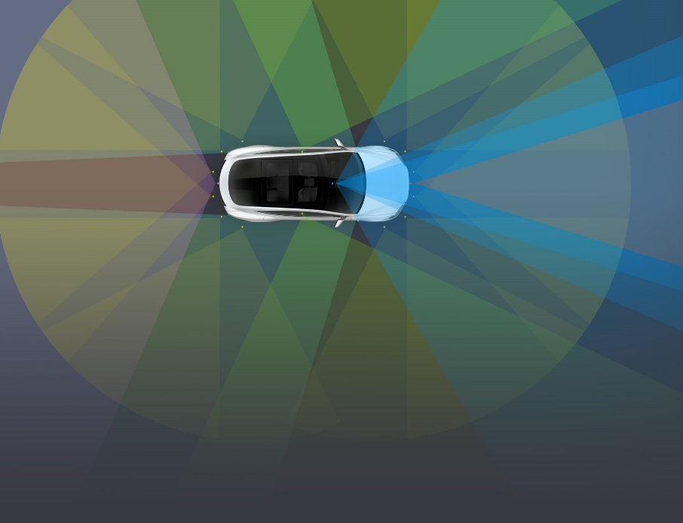
Computational Imaging Applications
Behind the scene
HDR IMAGING
FACE ID
SELF DRIVING CARS
https://commons.wikimedia.org/wiki/File:HDRI_Sample_Scene_Window.jpg
Source: Apple
https://sports.yahoo.com/used-infrared-camera-show-iphone-150400387.html
https://www.tesla.com/en_CA/autopilot
https://www.tesla.com/en_CA/autopilot
Combine multiple images that captured with different exposures
The camera system projects over 30000 dots on the face
The car has 8 cameras, 1 LIDAR and 12 ultrasonic sensors
Notes:
If we were to look behind the scene,
The HDR image is constructed by combining different parts of the images that were captured with different exposure settings.
[CLICK]
The camera systems that enable fast face unlock, projects over 30,000 dots using IR projector on the face to identify the distinctive features
[CLICK]
Self driving cars are packed with vision sensors. For example, Tesla model 3 has 8 cameras, 1 Lidar and a dozen of ultrasonic sensors which are used for navigation.

Slide 6
Motivation
✓ Multi-shot imaging: can boost image quality
✗ Motion artifacts: e.g., blur, blur non-uniformity, inter-frame variability
✓ High-frame-rate cameras: avoid motion artifacts
✗ High read noise and high power dissipation of the ADC
VIDEO FRAMES @ STANDARD RATE (e.g. 30-60 FPS)
EXPOSURE
READOUT/RESET
HIGH-SPEED VIDEO RATE (e.g. >10k FPS)
COMPUTATIONAL IMAGING FRAME TIME
→ Motion artifacts
COMPUTATIONAL IMAGING FRAME TIME
→ Power hungry
Notes:
From these examples we can see that
Multi-shot imaging has been a very popular technique in computational photography for boosting image quality.
Where [CLICK] a scene is captured multiple times with the different camera and illumination settings.
[CLICK] But it suffers from motion artifacts such as blur, non-uniformity, inter-frame variability
[CLICK]
One can employ high-frame-rate cameras to avoid motion artifacts,
but these come at the expense of higher read noise and higher power dissipation of ADC, due to the increased output data rate.

Slide 7
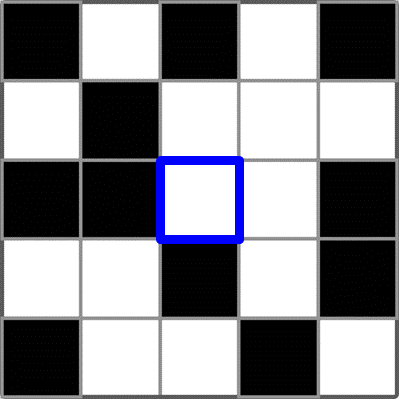
Motivation
✓ Per-pixel coding: programmable photo-generated charge sorting
✓ Enables single-shot computational imaging → reduced motion artifacts
✓ Multiple fast captures and tap-wise accumulation → no extra read noise
✓ Single high-precision video-rate readout → no extra ADC power
✓ Energy-efficient low-precision subframe-rate readout → adaptive exposure coding
CODE
1 | 1 | 0 | 0 | 1 | RST
Subexposures
Readout/Reset
TAP1
HIGH-SPEED VIDEO RATE (e.g. >10k FPS)
TAP2
COMPUTATIONAL IMAGING FRAME TIME
Notes:
We present a novel class of sensors with adaptive per-pixel coding, to tackle these problems and enable new applications
In the sensor, <CLICK> a frame is divided into multiple subframes
<CLICK> And in each subframe, a pixel can be independently programmed to collect the light in one of its two charge collection sites called taps.
//To sort the photo-generated charge among multiple storage nodes within the pixel, depending on it’s exposure code.
The exposure-code-rates similar to high-speed cameras can be achieved
- that enable, single-shot imaging and in such, it reduces motion artifacts
- Multiple fast captures and tap-wise accumulation boost the signal level but do not induce extra read noise
- a single high-accuracy readout can be performed at standard video rate so no extra ADC power is required compared to high-frame rate cameras
- Additionally, energy efficient 1-bit comparisons can be performed during every subframe to do adaptive exposure coding

Slide 8
Outline
Introduction to coded-exposure imaging
Architecture and operation
Dual-tap coded-exposure data-memory pixel
Multi-modal readout
On-chip mask generation
Single-shot imaging applications
High-dynamic-range
Structured-light
Conclusion
Notes:
I hope I motivated you enough to stick with rest of my talk as outlined here.
//This is the outline for rest of my talk
Next we’ll take a brief overview of existing implementations of per-pixel coded-exposure.
//introducing different types of coded exposure imaging techniques And
Then I will describe the architecture and operation of our sensor.
Finally I will show various experimental results including single-shot imaging applications,
such as,
- high-dynamic-range imaging with adaptive exposure time and
- structured light imaging with optimal projection patterns
before concluding this presentation.

Slide 9
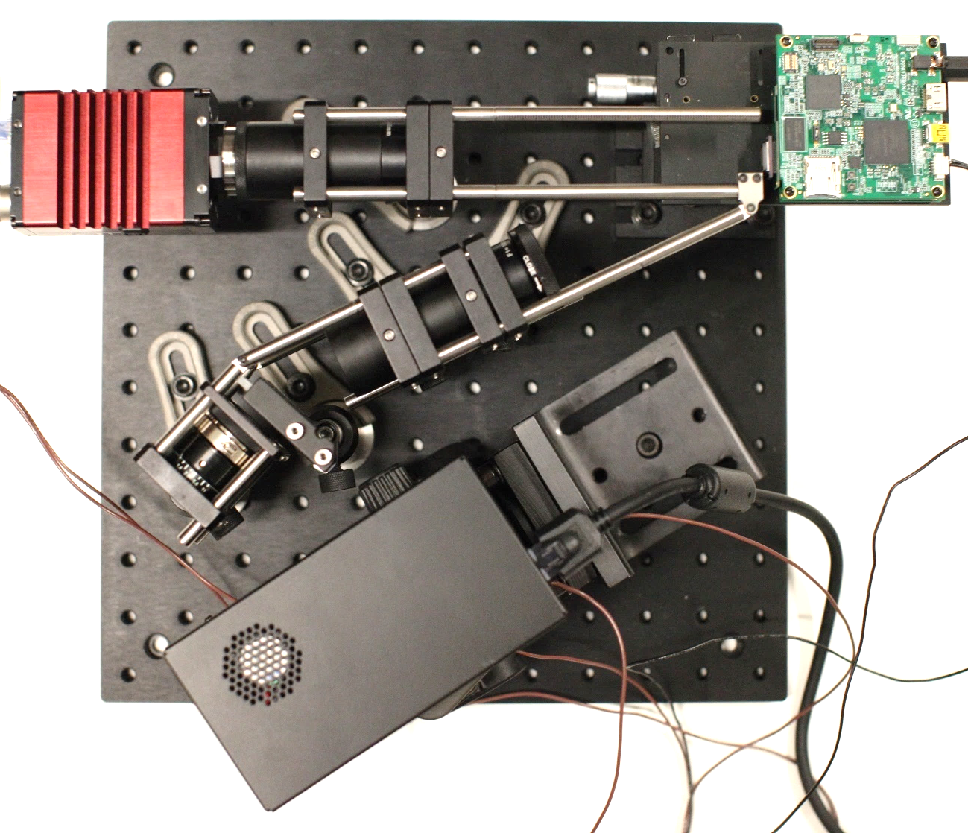
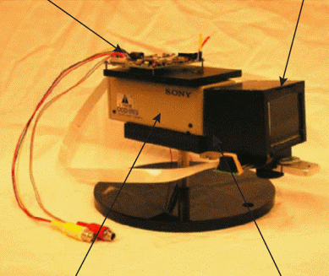
Per-Pixel Coded-Exposure: Existing Solutions
Using off-the-shelf components
DMD
Example pixel code
CAMERA
SLM CONTROL
SLM
OPTICS
PROJECTOR
CAMERA
OPTICS
[M. O’Toole et al. 2015]
[Nayar et al. 2003]
Bulky
Expensive
Limited optical signal fidelity
Single-tap implementation → light is lost
ON
EXPOSED
OFF
MASKED
Notes:
In the past, coded-exposure cameras systems have been implemented using off-the-shelf components.
In these systems, depending on the exposure code the light is either delivered to the pixel or not by these light modulating devices such as digital micromirror array and spatial light modulators.
Such systems are bulky and expensive
due to the sheer number and size of components.
At higher spatial resolution maintaining high optical fidelity is challenging
due to lens distortion, and mismatched components.
When pixel is masked/OFF, we end up losing some the light during exposure.

Slide 10
Per-Pixel Coded-Exposure: Existing Solutions
Integrated CMOS solutions
DUAL-TAP PIXEL
Example pixel code
SINGLE-TAP PIXEL
e⁻
e⁻
e⁻
e⁻
TAP1
TAP
e⁻
e⁻
e⁻
e⁻
PHOTODIODE
PHOTODIODE
[N. Sarhangnejad et al, 2019]
[Y. Luo et al 2022]
[J. Zhang et al, 2016]
TAP2
DRAIN
e⁻
e⁻
e⁻
e⁻
TAP1
TAP2
EXPOSED
MASKED
Compact system
Inexpensive
Per-pixel control
No photo-generated charges are lost
Single-tap implementation → light is lost
In-pixel PMOS → slower performance
Large in-pixel control → large pixel
Notes:
On the other hand, the integrated CMOS solutions are compact, inexpensive and offer per-pixel control which can easily scale with sensor resolution.
Some work has been done on per-pixel coded exposure on CMOS using single-tap and dual-tap pixel architecture.
Unlike dual-tap pixels, single-tap implementations still face the problem of losing the photo-generated charge when pixel is masked
The existing dual-tap pixel architectures contain either large control circuits or digital code memory with in-pixel PMOS
which results in larger pixel and cause lower subframe rate

Slide 11
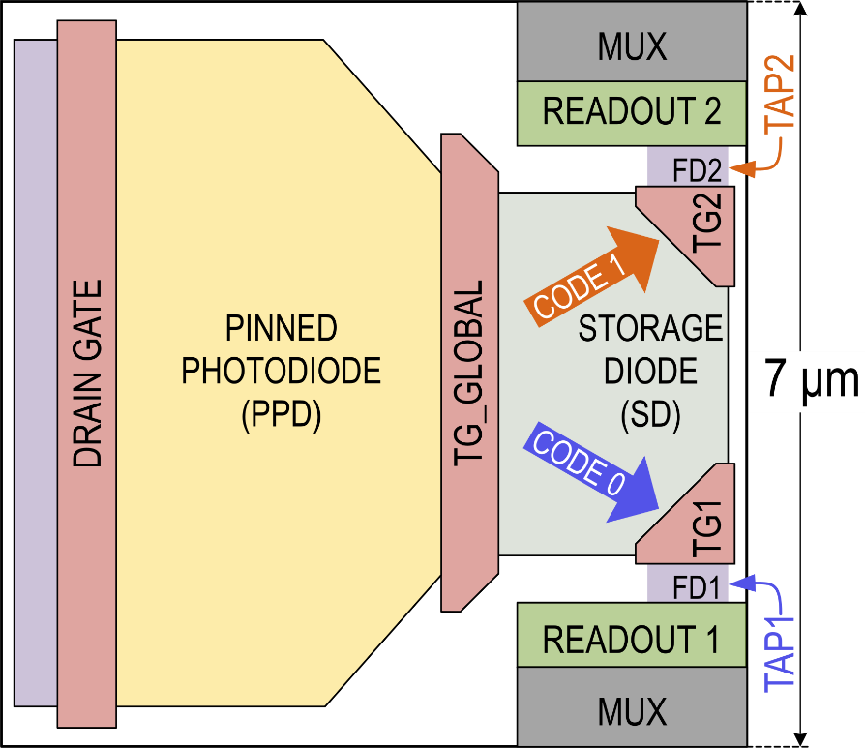
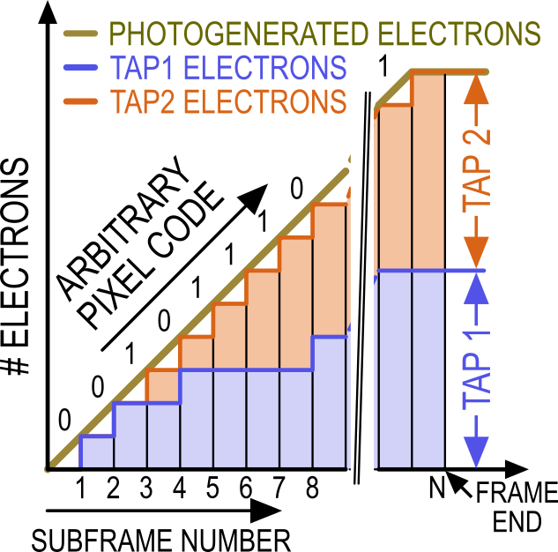
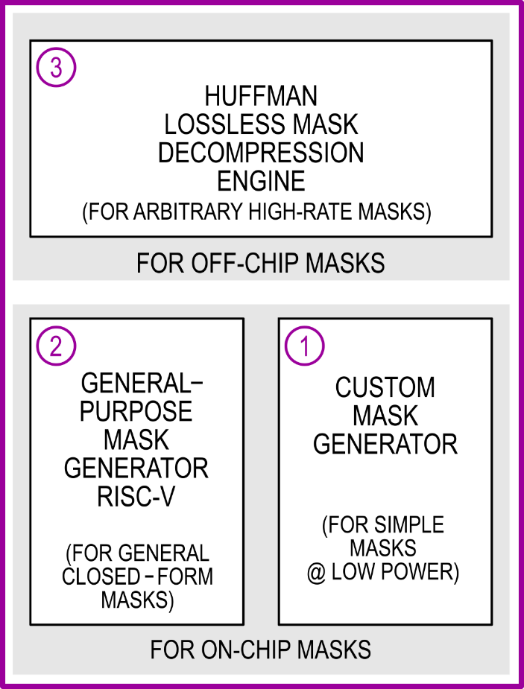
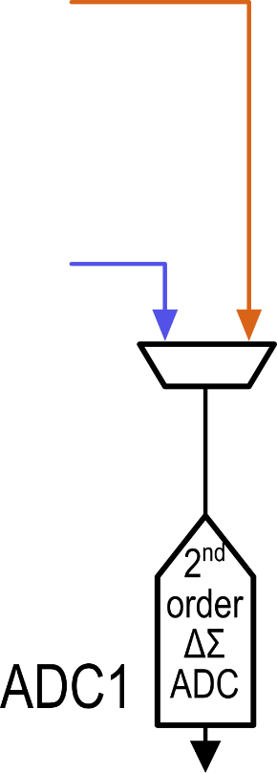
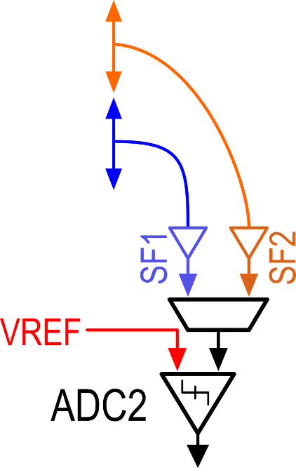
Per-Pixel Coded-Exposure: This Work
DUAL-TAP CODED-EXPOSURE
DATA-MEMORY PIXEL
ON-CHIP
CODE GENERATION
MULTI-MODAL ADCs
Fast coded-exposures
Small-pixel size
Compact system
Per-pixel control
Inexpensive
Fast adaptive coding
Energy efficient exposure-code generation
ADC1: Frame-rate high-precision readout
ADC2: Fast subframe-rate low-precision
Notes:
This work highlights 3 main contributions
First, the proposed Dual-tap coded-exposure DMP allows us to do fast per-pixel control
achieves small pixel size
And it carries forward all the benefits of CMOS based solutions, <CLICK>, mentioned earlier.
<CLICK>
The sensor also features two readout modes using ADC1 and ADC2.
ADC1 is a conventional high-accuracy ADC that converts each pixel-TAP voltage to a digital number at end of every frame.
<CLICK>
ADC2 is a fast subframe-rate 1-bit comparator that compares tap voltage with an external reference voltage during every subframe.
<CLICK>
Lastly, in this work we also show digital ASIC which consists of three main digital-processing blocks for exposure-code generation.
The on-chip code generation enables power-efficient and fast adaptive coding.

Slide 12
Outline
Introduction to coded-exposure imaging
Architecture and operation
Dual-tap coded-exposure data-memory pixel
Multi-modal readout
On-chip mask generation
Single-shot imaging applications
High-dynamic-range
Structured-light
Conclusion
Notes:
Next we will look into how each of these components operate in the sensor
Starting with Dual-tap data-memory pixel

Slide 13
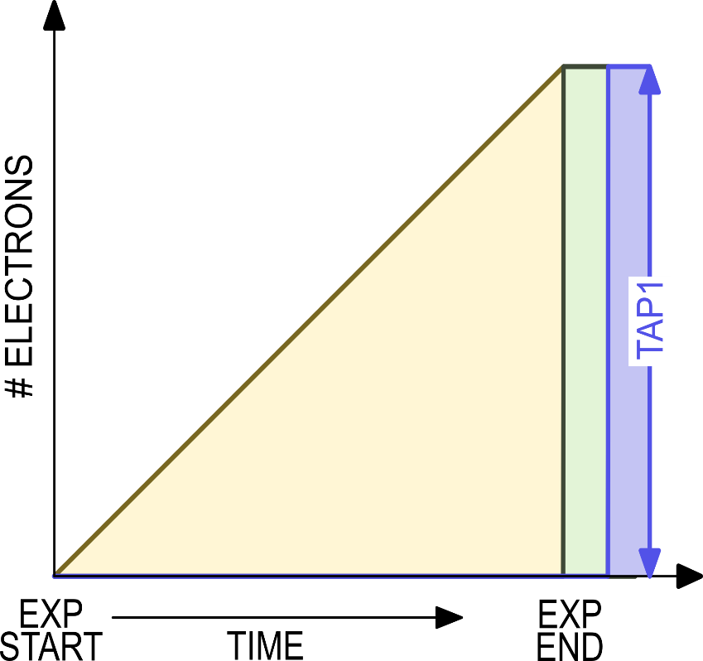
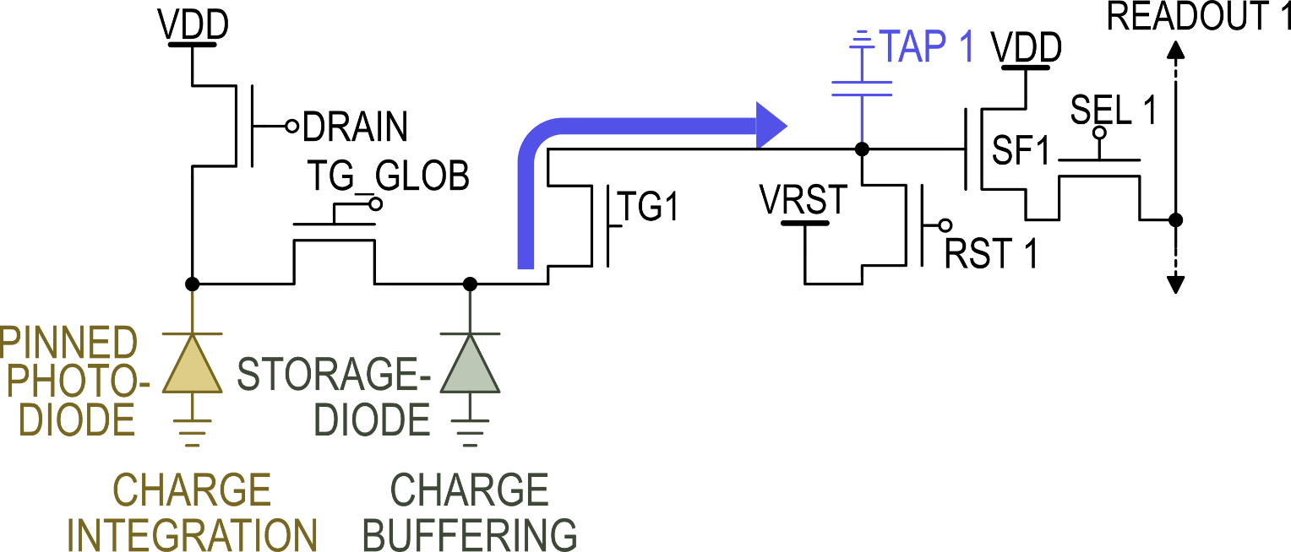
Conventional Data-Memory Pixel
PHOTO-DIODE ELECTRONS
STORAGE-DIODE ELECTRONS
TAP1 ELECTRONS
Notes:
This slide shows conventional data memory pixel also known as charge-domain or global-shutter pixel.
It consists of
photo-diode,
storage-diode which we call data memory and .
charge collection site denoted by TAP
The timing diagram on the bottom shows,
That a frame is divide into RST, EXPOSURE and READOUT phase for ADC operation.
The graph on the right shows number of electrons at different nodes in the pixel during a frame-time.
During exposure <CLICK> Photo-generated charge is accumulated in the photo-diode
At the end exposure <CLICK> this charge is transferred from photo-diode to storage diode or what we call data-memory.
//The global signal assertion allows us to perform global shutter operation across the sensor array.
The charge is buffered in data-memory node until it is transferred to floating diffusion or TAP1 <CLICK> row-by-row
for readout using conventional ADC.

Slide 14
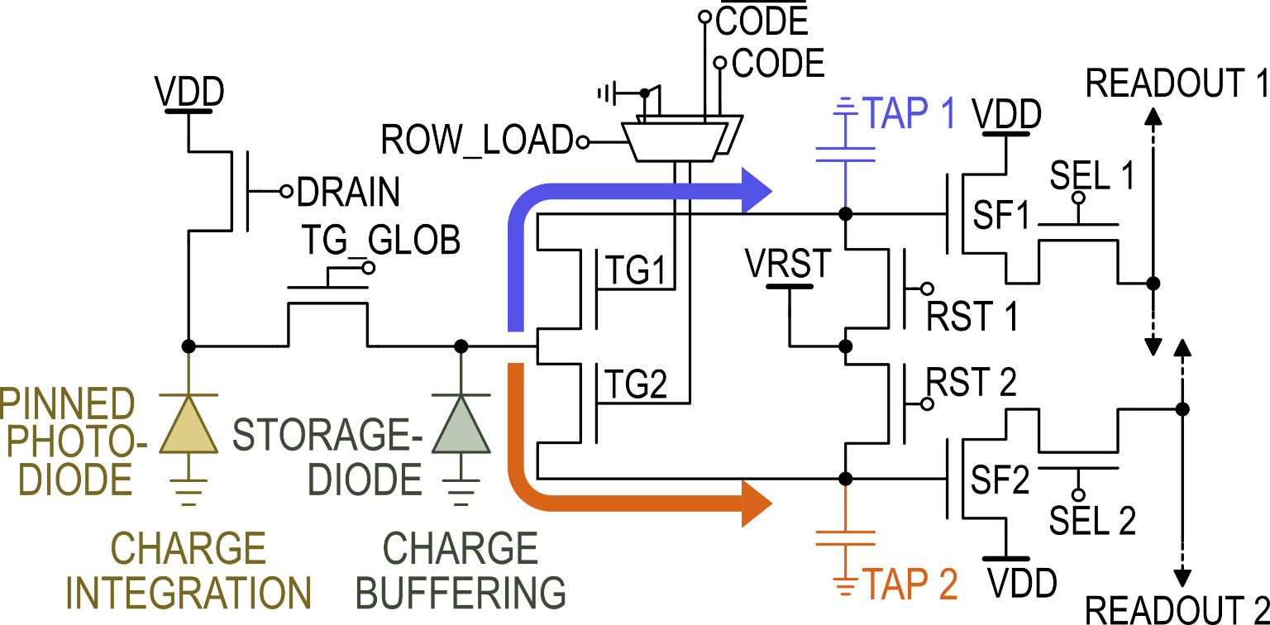
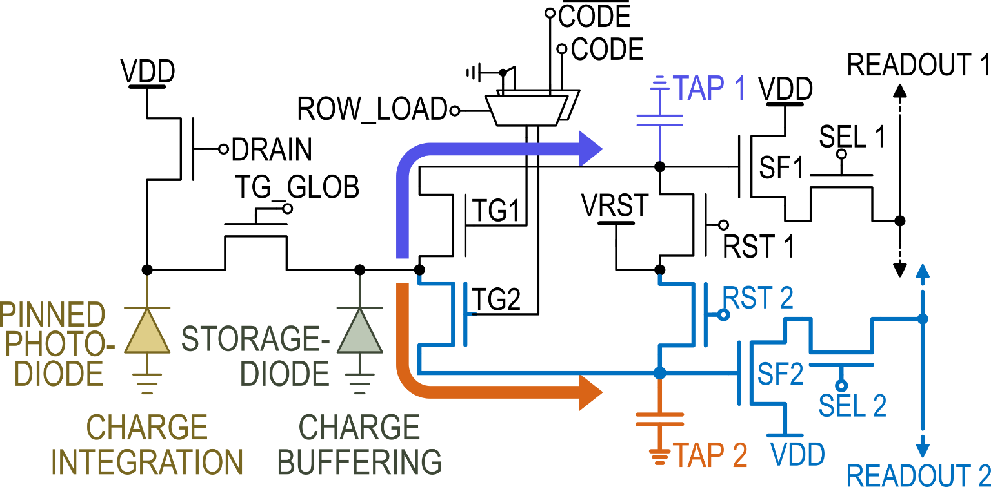
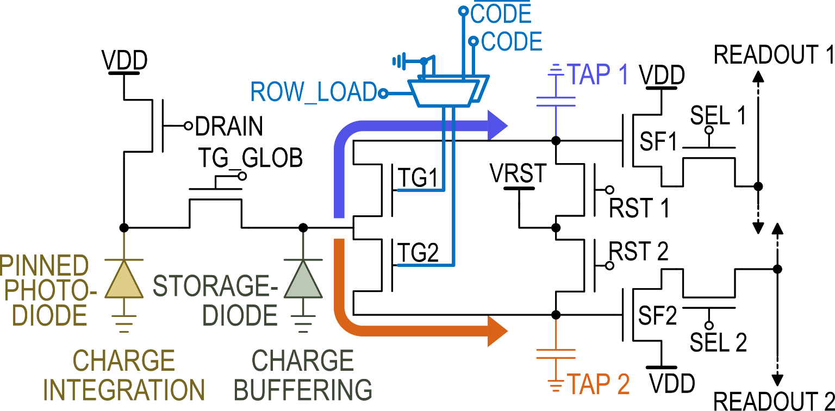
Dual-tap Coded-Exposure Data-memory Pixel
Dual-tap Coded-Exposure Data-memory Pixel
Dual-tap Coded-Exposure Data-memory Pixel
Notes:
This is the schematic of dual-tap data-memory coded-exposure pixel.
<CLICK>
By mirroring the part of the conventional pixel
we add a second tap to realize dual tap data-memory pixel.
The pixel now has two charge collection sites TAP1 and TAP2 and controlled by transfer gate TG1 and TG2
<CLICK>
These transfer gates are connected to a pair of simple nmos-only 2:1 multiplexers which allows us to do per-pixel coded-exposure
//Row-wise ROW_LOAD signal and column-wise CODE signal allow to upload to
//in combination with row-wise LOAD signal allows per-pixel
//The transfer gates, TG1 and TG2, are controlled through these

Slide 15
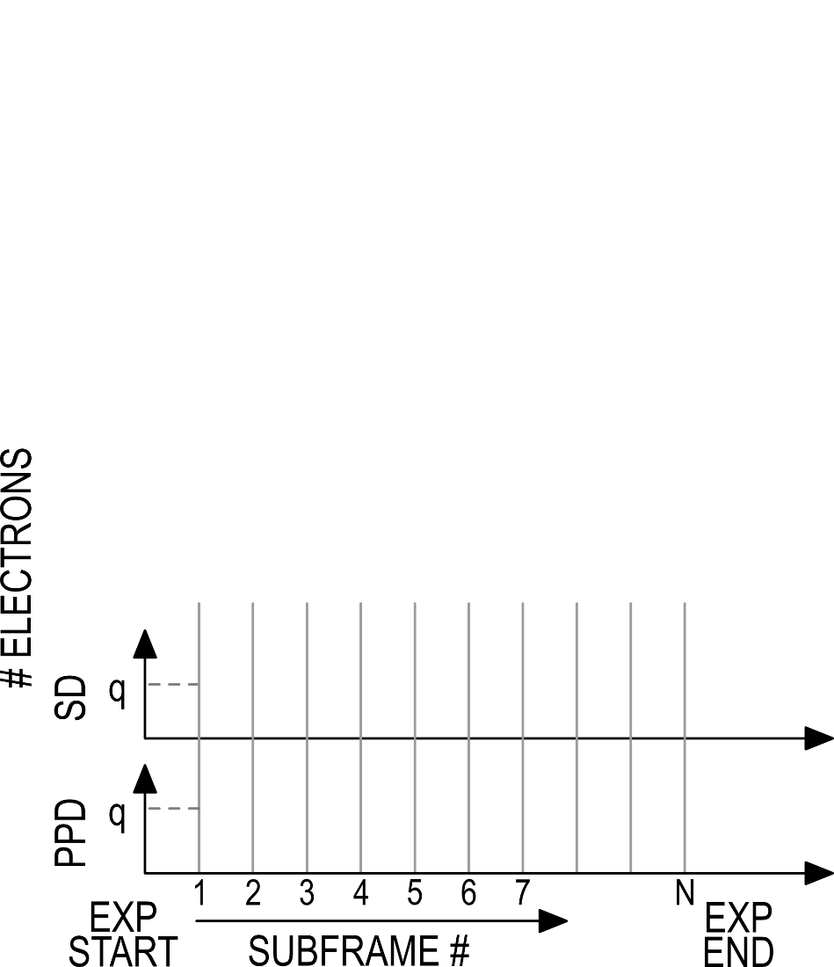
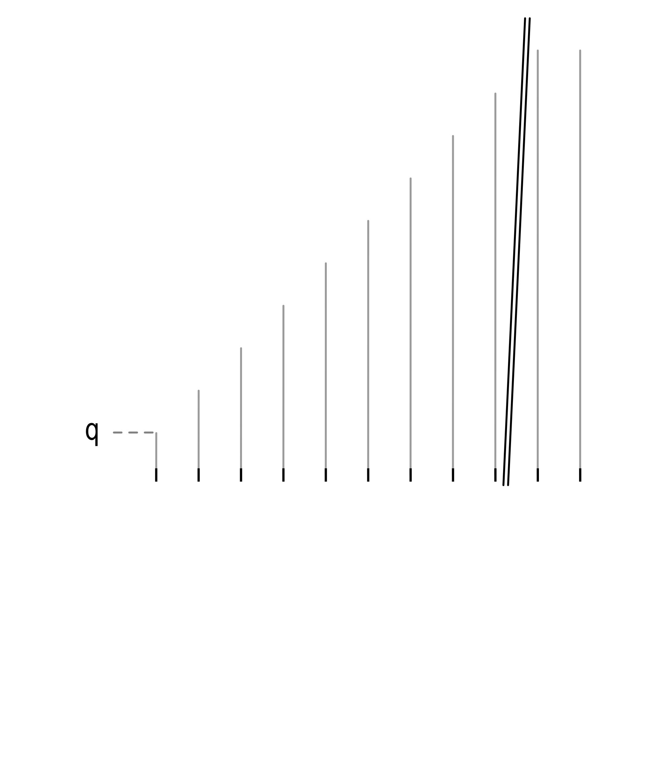
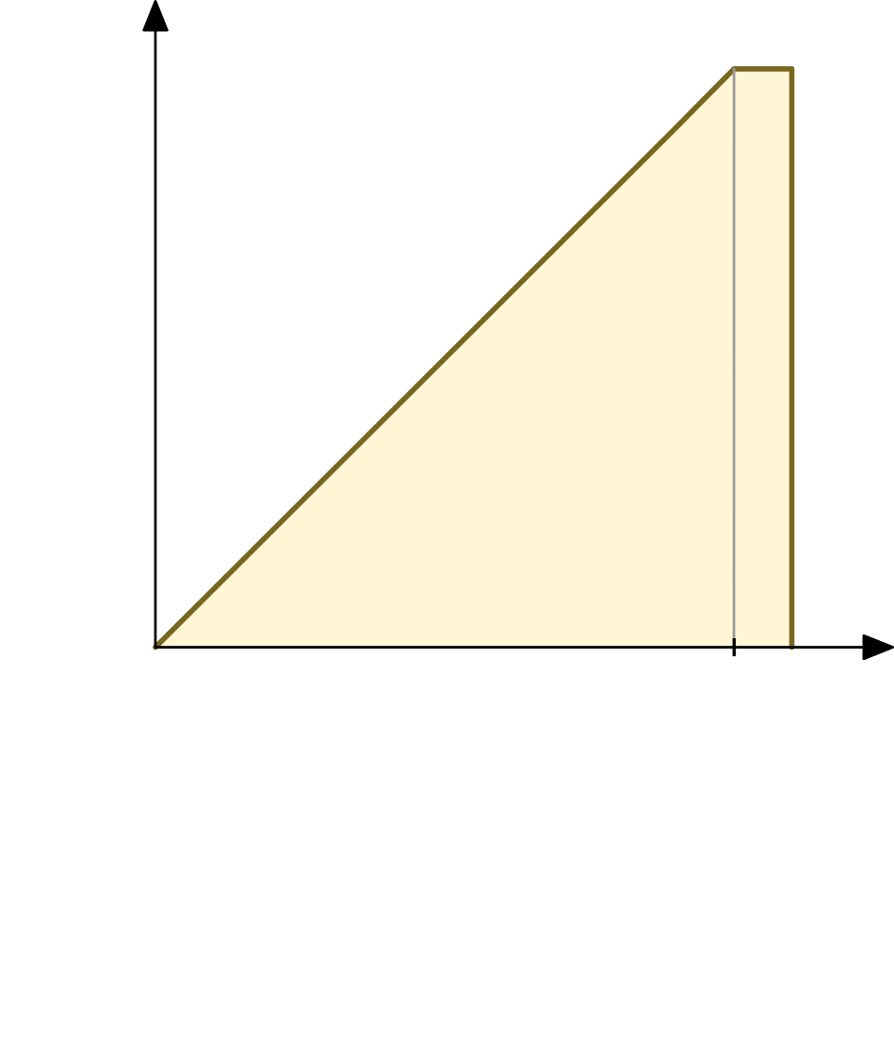
Dual-tap Coded-Exposure Data-memory Pixel
PHOTO-GENERATED ELECTRONS
PHOTO-GENERATED ELECTRONS
TAP1 ELECTRONS
TAP2 ELECTRONS
#ELECTRONS
Notes:
Next we will have a look at the pixel operation.
As mentioned earlier,
<CLICK>
In coded-exposure cameras, the frame time is divided into multiple subframes.
<CLICK>
Each subframe has two parts, exposure and coding, performed in pipeline fashion.
Compared to conventional pixel, the TAP transfer gates<CLICK> are now controlled by combination of CODE and ROW_LOAD signal for charge sorting
Here on the right hand side, the graph shows the total photo generated charge during an exposure.
<CLICK>We divide the exposure time into N subframes.
<CLICK>Next we will look at how the charge is transferred from PhotoDiode to StorageDiode to TAPs based on exposure codes.

Slide 16
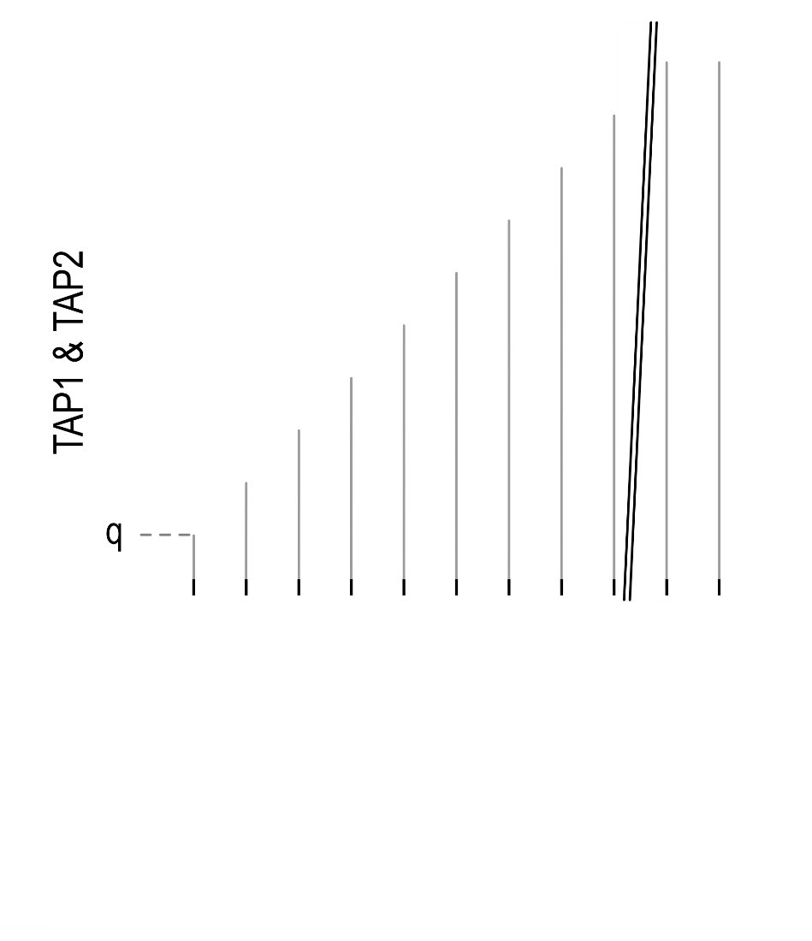
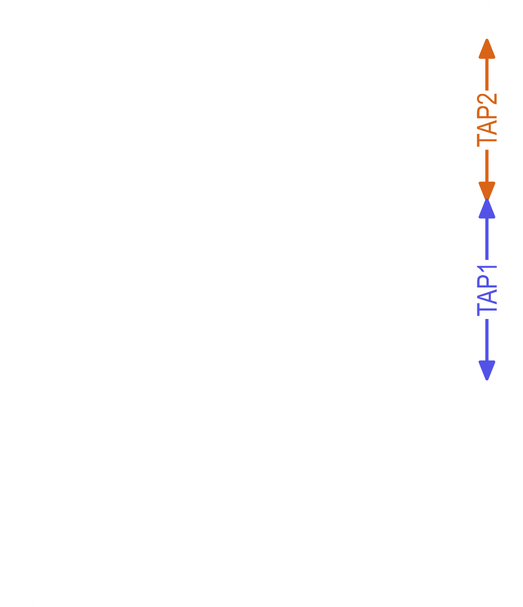
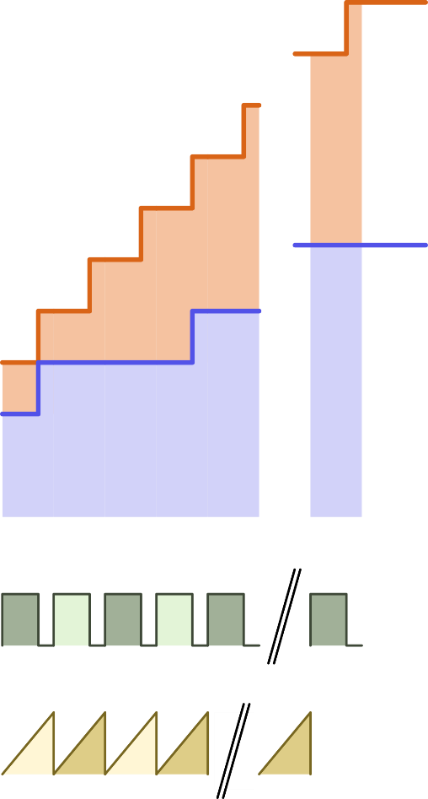
Dual-tap Coded-Exposure Data-memory Pixel
PHOTO-GENERATED ELECTRONS
TAP1 ELECTRONS
TAP2 ELECTRONS
Notes:
In a given subframe exposure <click>,
the photo-diode accumulates the photo-generated charge in it.
The global signal TG_GLOB <CLICK> is asserted to mark the end of every subframe exposure.
It transfers the charge from photo-diode to data-memory across all the pixels in the array.
This allows us to achieve the global shutter operation.
The charge is STOred in the data-memory until it is transferred to one of the TAPs based on the exposure-code.
<CLICK> The code is applied to transfer gates when ROW_LOAD signal is asserted for a given row.
While the charge is sorted to respective TAPs
<CLICK>the photo-diode continues to collect the light.
After the charge sorting is complete for all the rows,
the TG_GLOB signal <CLICK> can be asserted to mark the end of the second sub-exposure.
<CLICK>It is then again followed by row-wise coding for second subframe.
<CLICK>
And these steps are repeated for all the subframes. <CLICK>
At the end of the exposure period, all the photo-generated charge is either collected in TAP1 or TAP2
And none of the charge is lost due to coded-exposure.

Slide 17
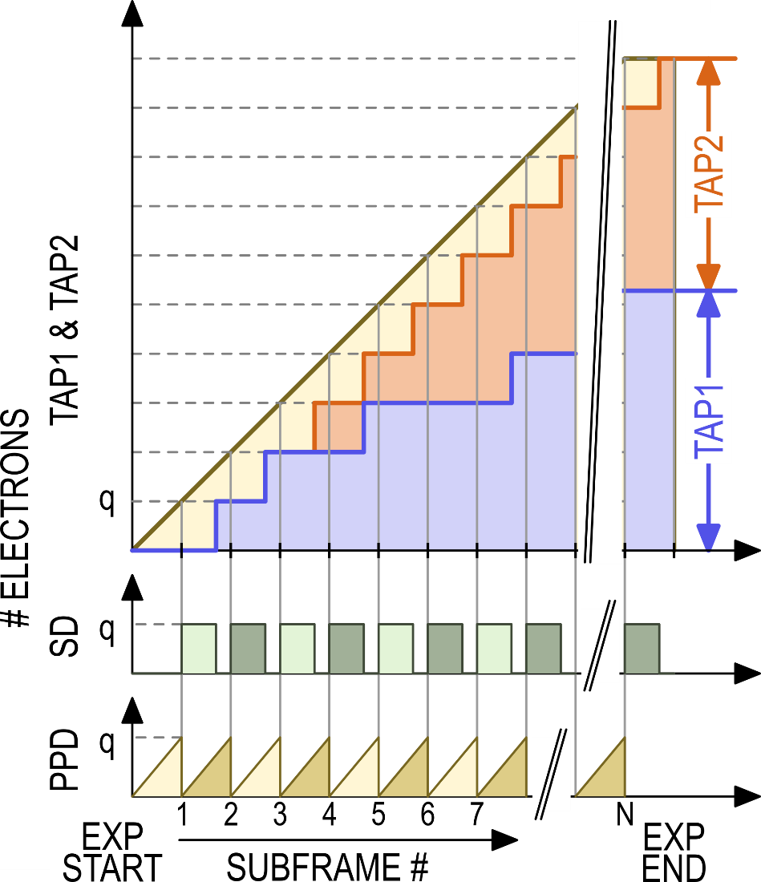
Dual-tap Coded-Exposure Data-memory Pixel
PHOTO-GENERATED ELECTRONS
TAP1 ELECTRONS
TAP2 ELECTRONS
Notes:
Similar to conventional image sensors,
//the amount of photo-generated in each TAP is digitized by ADCs.
This sensor also has column-parallel 2nd order delta-sigma ADCs that digitizes each pixel-TAP row-by-row during the readout phase.

Slide 18
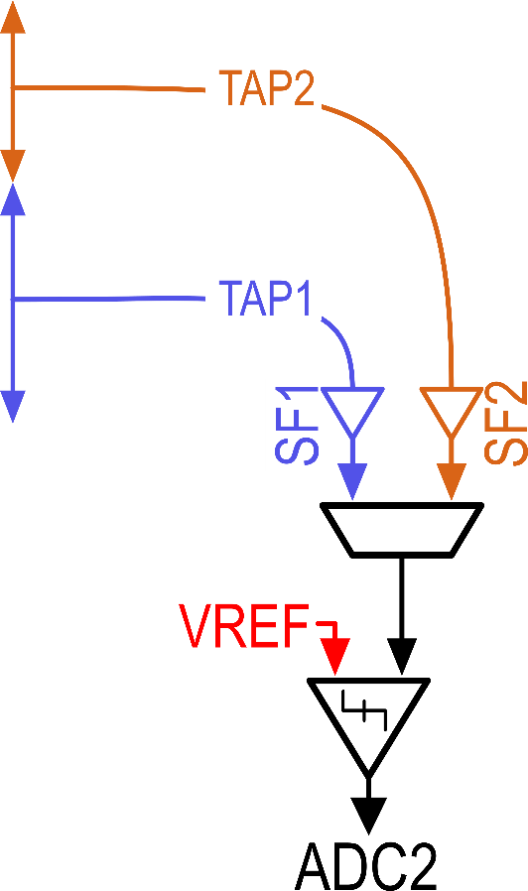
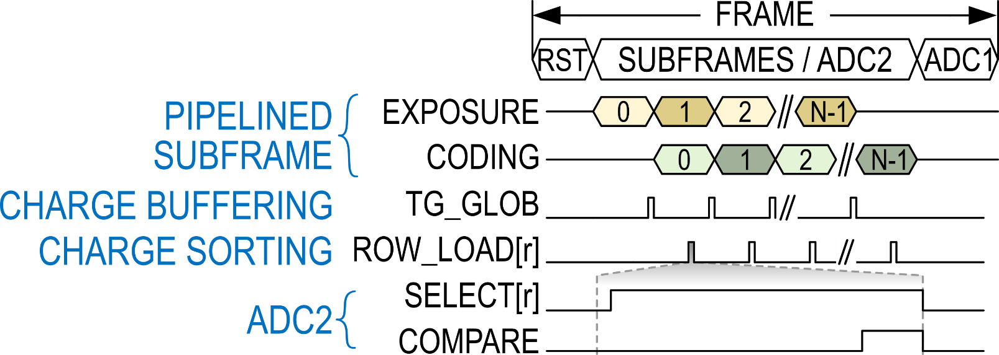
Dual-tap Coded-Exposure Data-memory Pixel
PHOTO-GENERATED ELECTRONS
TAP1 ELECTRONS
TAP2 ELECTRONS
Notes:
Additionally,
The sensor also features column-parallel 1-bit ADCs which compare the pixel-TAP voltage with a reference voltage during every subframe.
//The comparators generate a thermometer style bitstream output for each pixel-TAP.
This allows us, to monitor the development of TAP voltage during each frame but at subframe-speeds and adjust the exposure codes adaptively based on the application.
//For example, in case of single-shot HDR imaging this feature is used to avoid saturating one of the TAPs
//When a row is selected for uploading an exposure-code to the pixel, the voltage from each tap is buffered on READOUT lines through the source followers.
//The length of the raw output is equal to number of subframe.

Slide 19
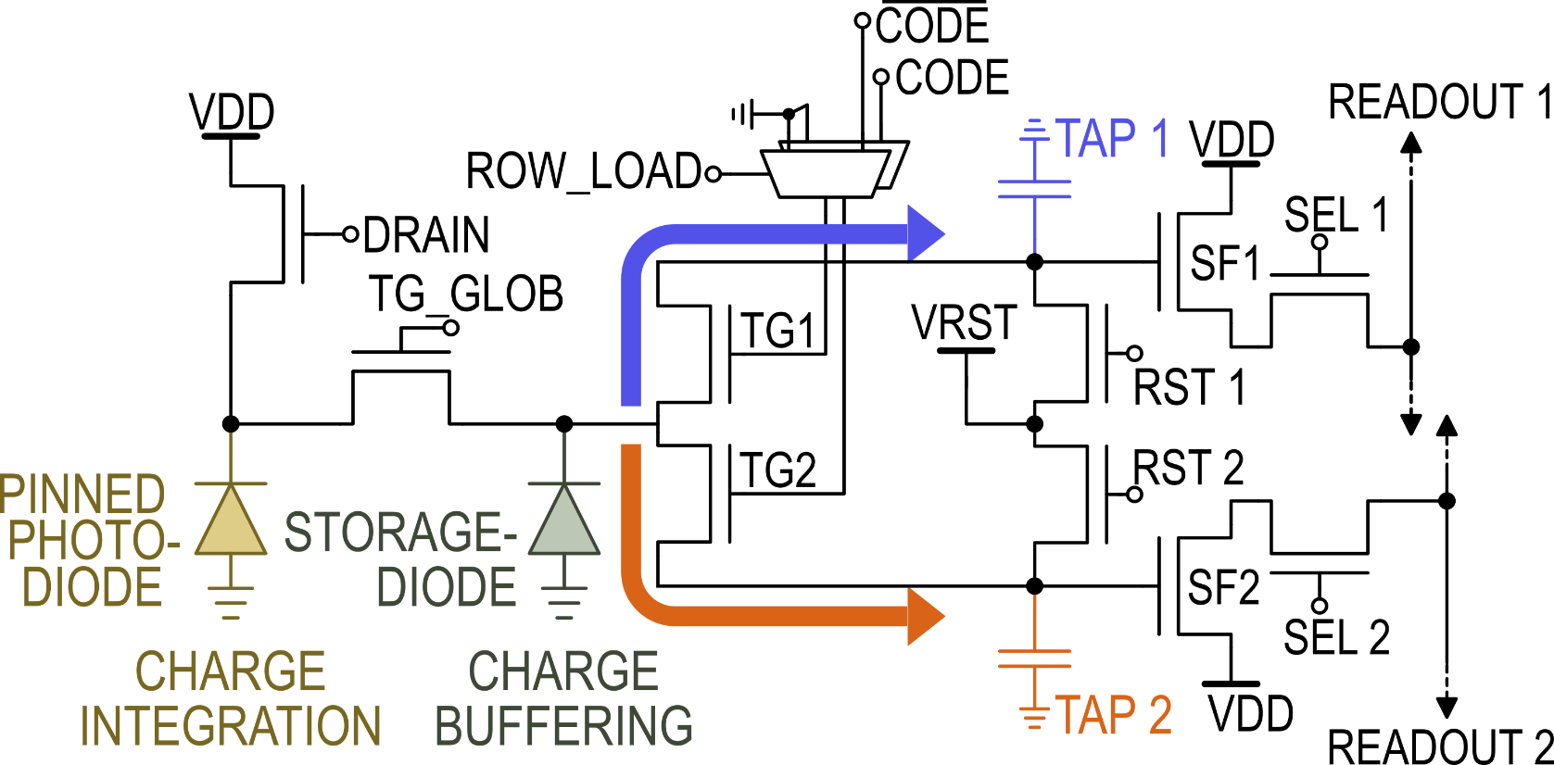
Dual-tap Coded-Exposure Data-memory Pixel
Notes:
The slide here shows, the schematic and layout of the dual-tap data-memory coded-exposure pixel.
The pixel pitch is 7um with fill factor of 38%.
//The TAP1 and TAP2 sides in the pixel are layout symmetric to minimize systematic mismatch.

Slide 20
Multi-Modal Readout
ADC1: Conventional Frame-Rate 12-bit
ADC2: Subframe-Rate 1-bit
Notes:
This slide summarizes the two readout modes the sensor offers.
The ADC1 is conventional frame-rate ADC. It digitizes TAP1 and TAP2 voltage to high-accuracy at end of every frame
And ADC2 is an 1-bit comparator that compares TAP voltage in every subframe.
The sensor also features ADC2 which is fast subframe-rate 1-bit ADC.
It compares the level of charge in pixel-tap with a known reference voltage during every subframe.
The coarse but fast ADC2 output can be used to adaptively adjust the per-pixel exposure codes.

Slide 21
On-chip Mask Generator Overview
Application dependent mask generator selection
65nm CMOS DIGITAL MASK GENERATOR
CUSTOM MASK GENERATOR
4.2mm
SCAN LINES
TILED
PSEUDO-RANDOM
HUFFMAN DECOMPRESSION ENGINE
RISC-V
WITH LOW SPATIAL-FREQUENCY
OTHER ARBITRARY
3.3mm
Notes:
In this work, we also implemented digital mask generator ASIC which consists of 3 main blocks.
//The type or complexity of masks are dependent on the computational imaging application.
//We divide the mask generator ASIC to into 3 blocks for 3 different sets of masks
<CLICK>The custom mask generator block is the smallest of them all and it takes care of simplest set of masks.
These masks could have simple scan lines, tiled patterns or
they could be pseudo random in nature.
<CLICK>The masks that have low-spatial frequency such as the stripes shown here,
are compressed before sending to the sensor and decompressed on-chip using lossless Huffman decompression engine.
By shipping less bits over long wires and processing them on chip, we make whole system power efficient.
Finally, the on-chip RISC processor is connected to both the image sensor output and masking circuit.
It can either adaptively generate masks based on the ADC1 and ADC2 outputs.
Or It can create masks which could not be efficiently generated using one of the previous two methods.

Slide 22
Chip Micrograph
110nm CIS
IMAGE SENSOR
65nm CMOS
DIGITAL MASK GENERATOR
4.2mm
3.3mm
3.3mm
Notes:
These are the micrographs of the two chips presented in the work.
The image sensor is manufactured in 110nm CIS technology.
And It has pixel array of size 320 x 320
The digital mask generator chip is fabricated in 65nm technology.

Slide 23
Outline
Introduction to coded-exposure imaging
Architecture and operation
Dual-tap coded-exposure data-memory pixel
Multi-modal readout
On-chip mask generation
Single-shot imaging applications
High-dynamic-range
Structured-light
Conclusion
Notes:
Now, let’s have a look at some of the experimental results

Slide 24
Example: Coded-Exposure Imaging
EXPOSURE CODE [n]
TAP2 EXPOSURE TIME
TAP1
TAP2
SCENE
EXAMPLE 1
EXAMPLE 2
Framerate=30 fps, #subframes=256
Notes:
This slide shows simple examples of coded-exposure.
The binary image on the left is an exposure code for one of the subframes in a frame.
<CLICK>
The video shows the sequence exposure codes used to realize exposure time for TAP2 as shown here on the right.
<CLICK>
The resulting TAP1 and TAP2 videos are shown here which are captured under uniform lighting
//The intensity variation that we see is due to exposure time variation.
//The realized exposure time for TAP2 due to these exposure-code sequence is shown in this figure on the right.
//The intensity of a pixel in this image, is equivalent to fraction of exposure time for the pixel.
<CLICK>
But, we don’t have to stop at these mathematically generated set of exposures codes. In this example, we take an 8-bit grayscale picture and
<CLICK> convert it into 256 exposure codes corresponding to each intensity level.
//The video on the bottom left shows the exposure codes for different subframes in a frame.
The resulting coded-exposure TAP1 and TAP2 videos are shown on the right

Slide 25
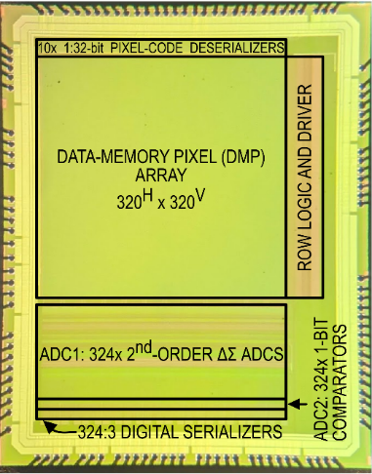
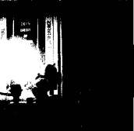
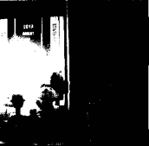
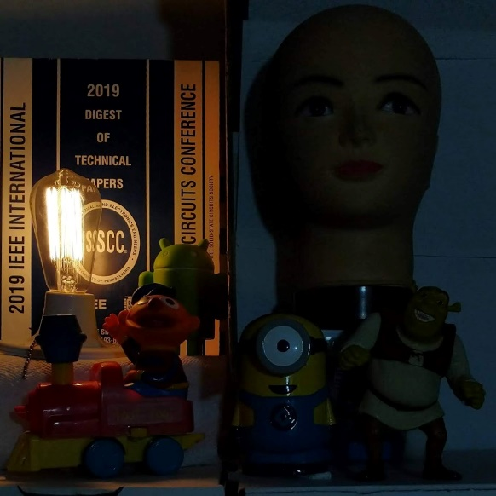
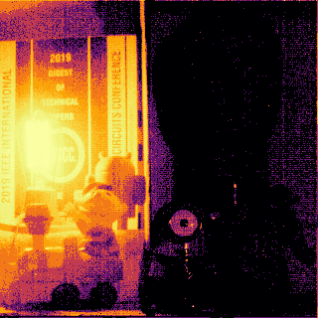
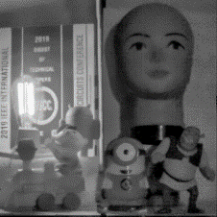
Application1: Subframe-Rate Scene-Adaptive HDR
SCENE: HIGH EXPOSURE
CEP IMAGE SENSOR
ADC2 & MASKS
ADC2
MASKS
ADC1
0
1/4
1/2
3/4
1
RECONSTRUCTED HDR WITH TONE MAPPING
SCENE: LOW EXPOSURE
RAW OUTPUT
EXPOSURE TIME
Notes:
Now let’s have a look at methodology and experimental results for subframe-rate scene-adaptive single-shot HDR imaging.
The two pictures on the left are captured by conventional camera with high and and low exposure settings.
[CLICK]
The CEP image sensor captures the scene [CLICK]
and generates 1-bit output for all the pixels at the end of the first subframe
This output is fed back to the sensor as masks [CLICK] for the next subframe.
[CLICK] In the following subframe,
some of the pixels have crossed the reference voltage and must stop integrating light any further to avoid saturation.
So the corresponding masks are updated on the sensor.
[CLICK] [CLICK] We see more and more bright pixels start crossing the refererence voltage during the frame.
[CLICK] at the end, ADC1 digitzes the raw output from the sensor
[CLICK] the effective per-pixel exposure time is calculated from ADC2 output.
[CLICK] the combination of ADC1 and ADC2 is then used to determine the intensity of each pixel.
The tone mapped HDR scene is shown in the bottom right corner

Slide 26
Application1: Subframe-Rate Scene-Adaptive HDR
ADC1 OUTPUT
TAP1
ADC2 OUTPUT
PER-PIXEL EXPOSURE TIME
COMPUTED HDR
(mapped to LDR)
0
1/4
1/2
3/4
1
FRAME RATE 10 FPS
FRACTION OF EXPOSURE TIME
42dB ADAPTIVE HDR BOOST
Notes:
This slide shows video example of the HDR imaging with scene-adaptive exposure time.
The video on the left is the RAW output of the sensor digitized using frame-rate ADC1.
The middle video shows the per-pixel exposure time obtained using adaptive coding and ADC2 output
The video on the right shows the HDR output mapped to LDR space for easier viewing
In the video we can see Toronto Skyline on bright sunny day and dark corners inside the room.
//In this video, we boost the dynamic range by 42dB by adaptive coding.

Slide 27
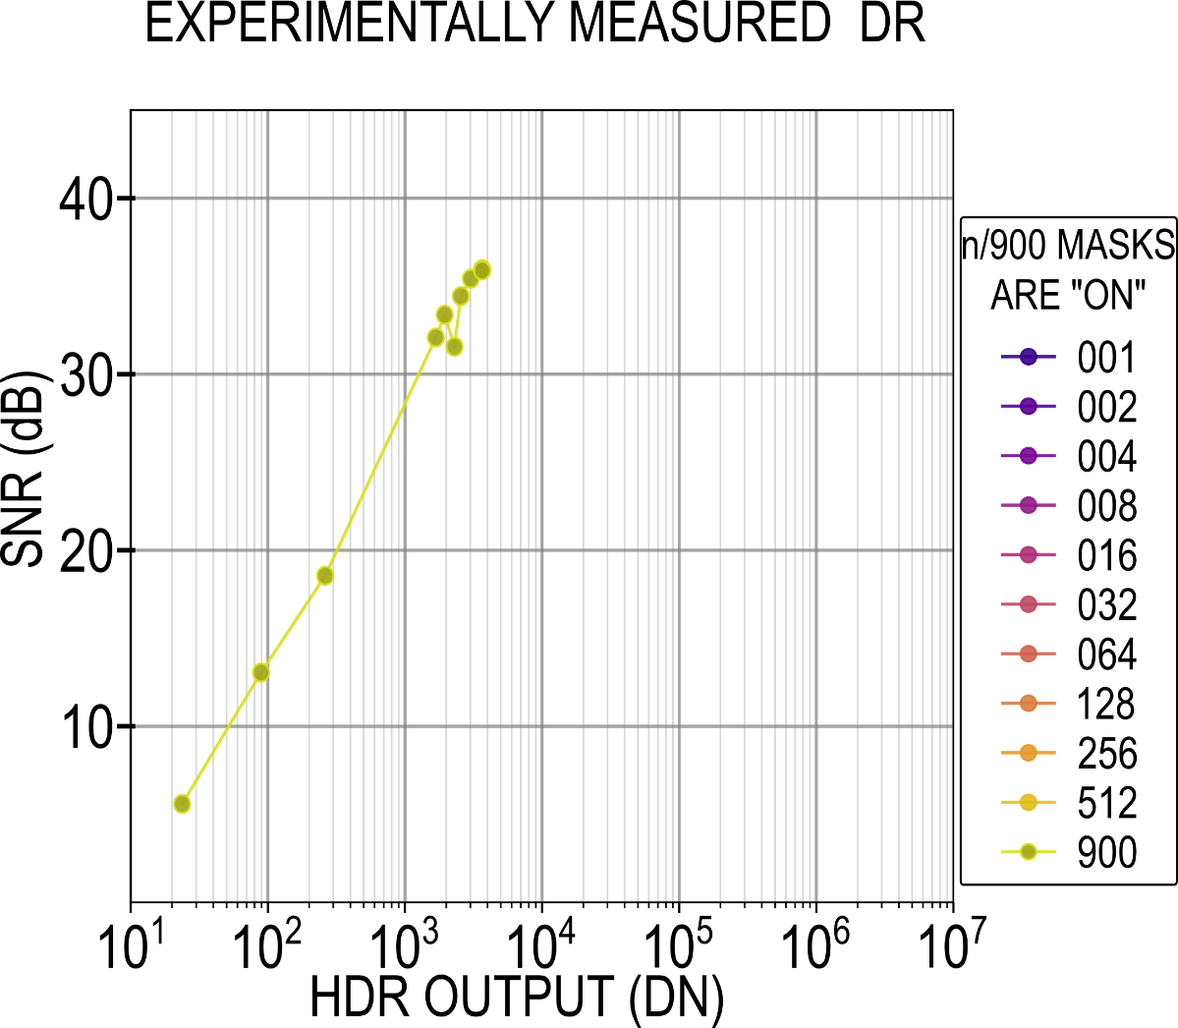
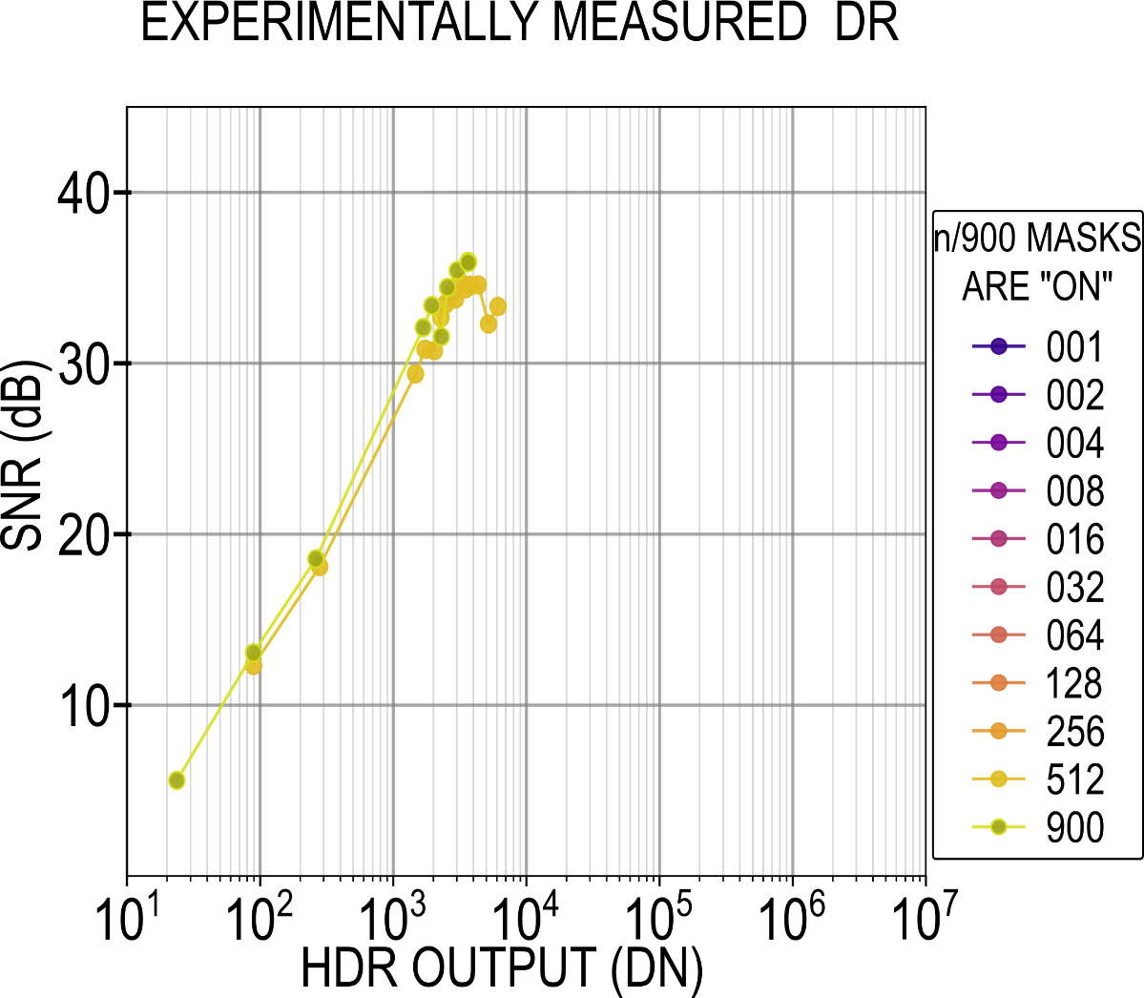
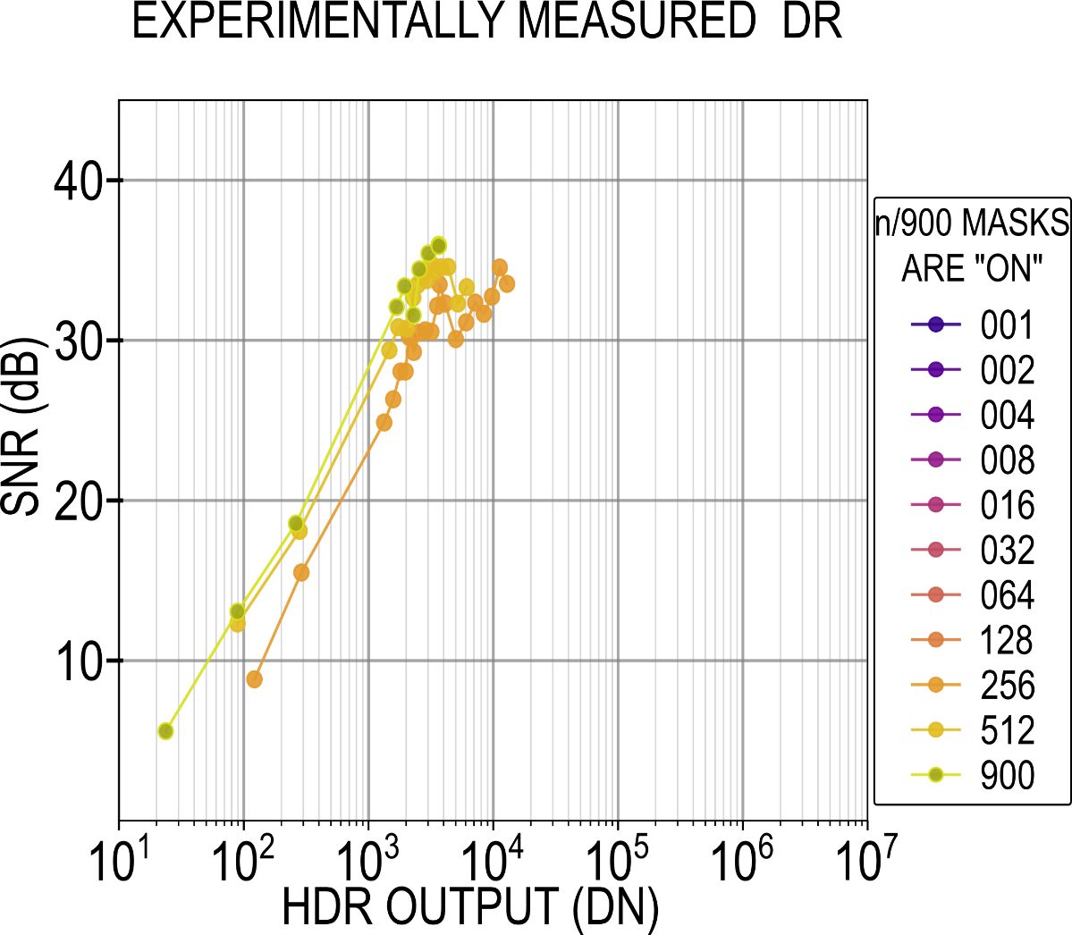
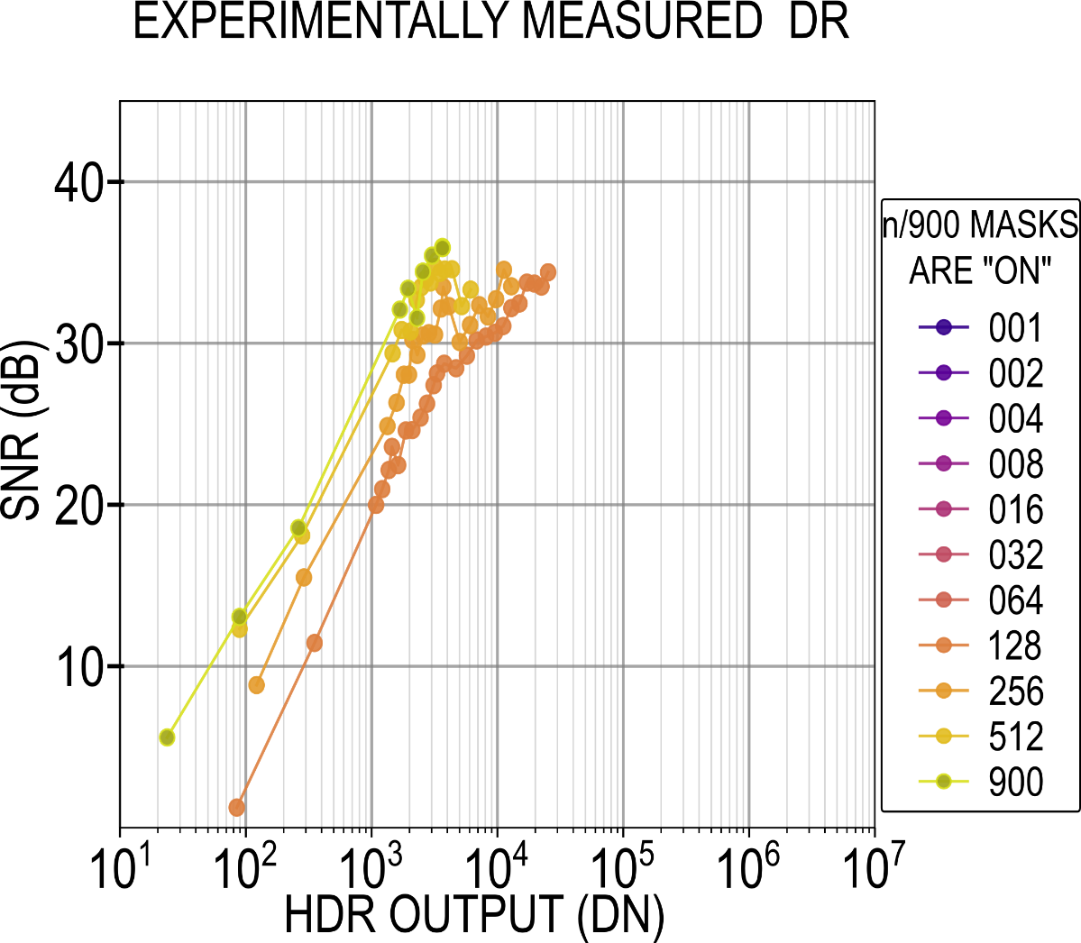
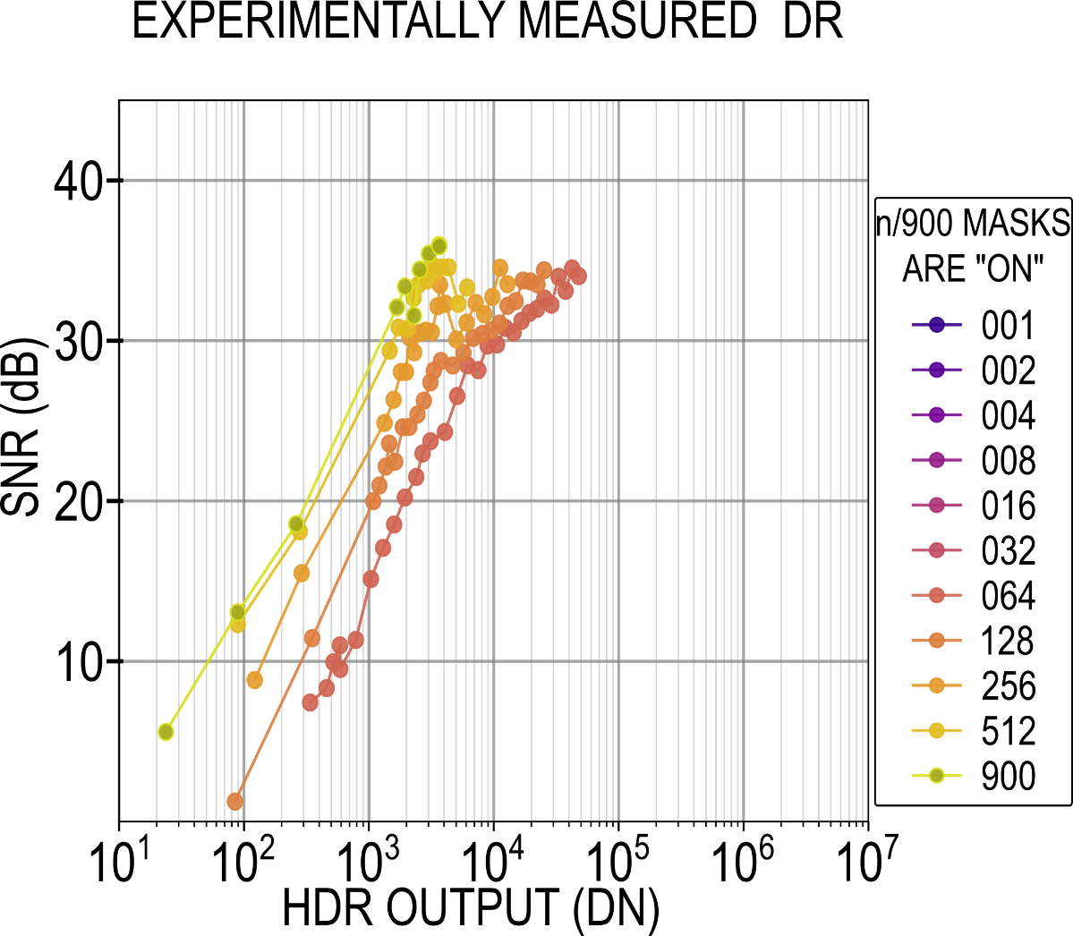
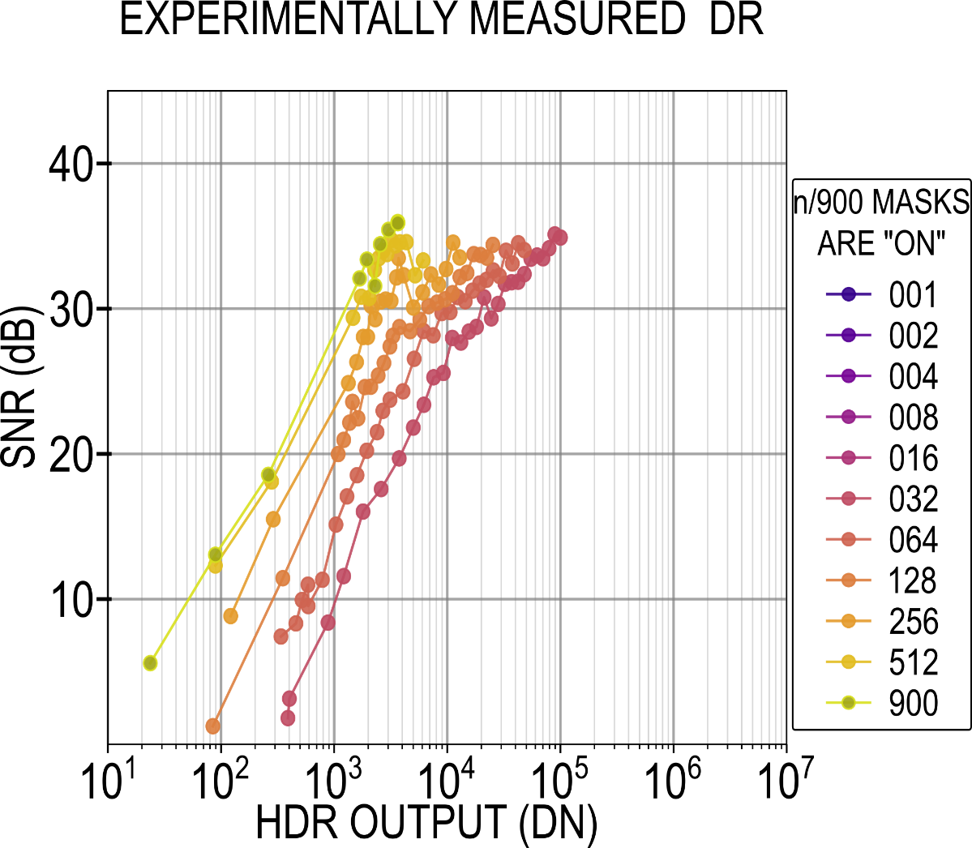
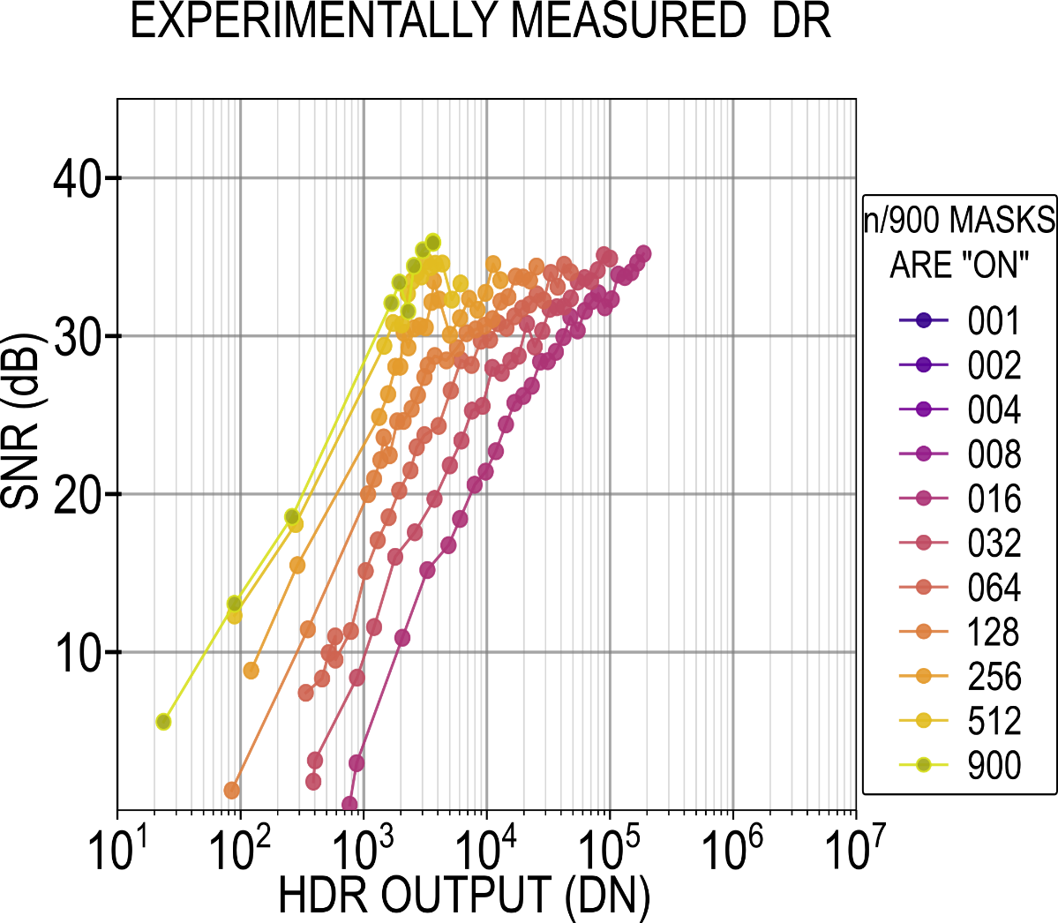
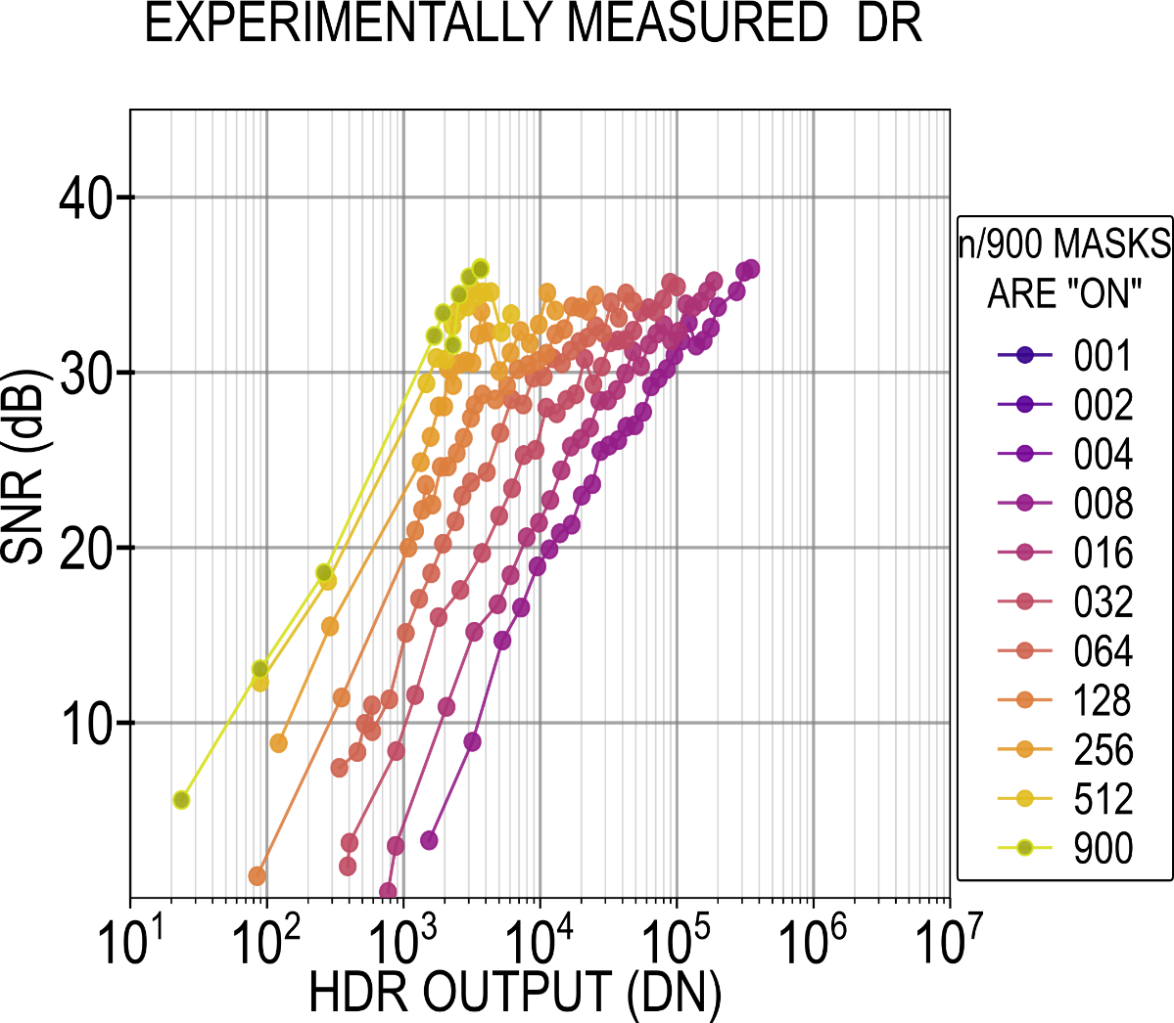
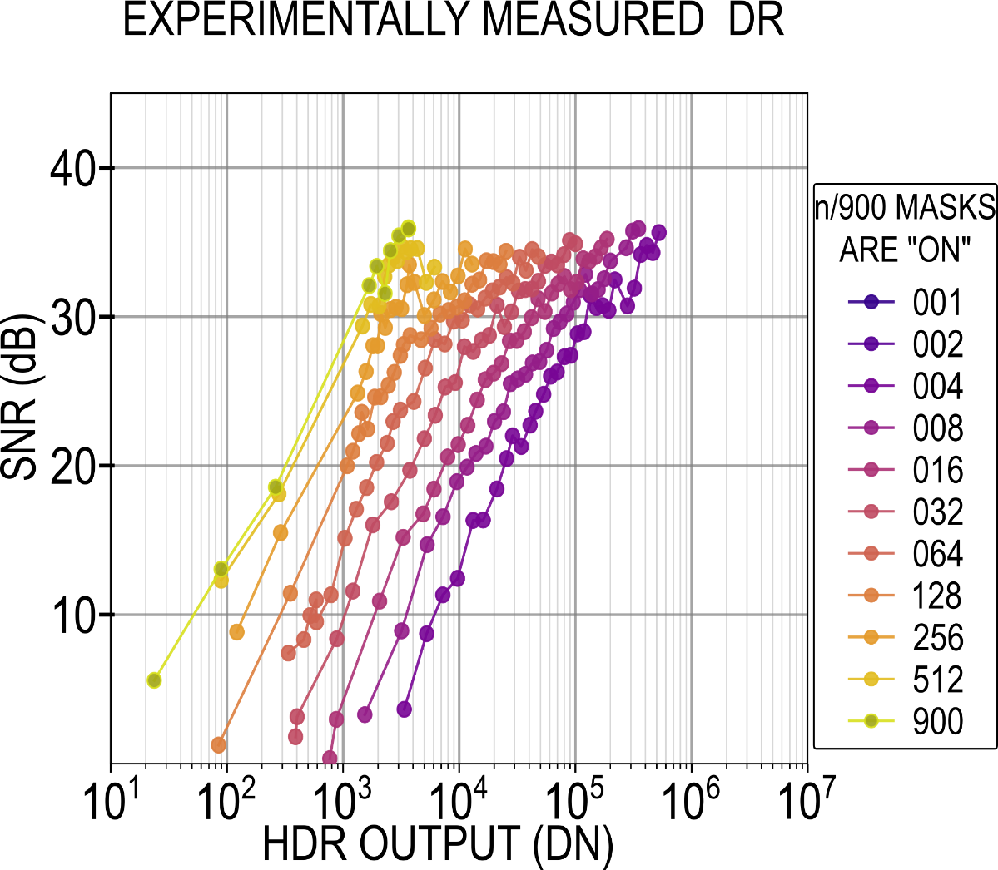
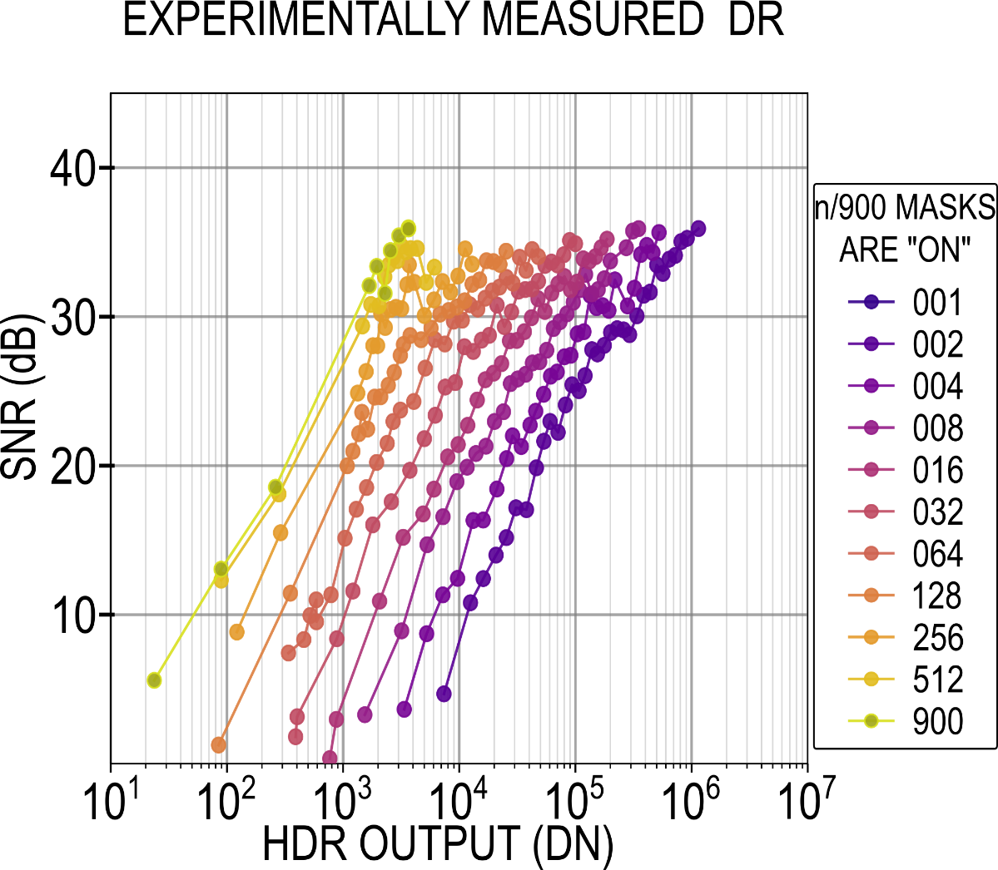
Application1: Subframe-Rate Scene-Adaptive HDR
Experimentally measured SNR plot
for different exposure codes
SATURATION
(without coding)
SATURATION
(with coding)
Native DR
54 dB
Adaptive coding boosted DR
57.5 dB ≈ 20log₁₀(N)
No dip
in SNR
Noise
floor
Total DR
Native + Adaptive = 101.5 dB
Notes:
<CLICK> <CLICK>
This is experimentally measured SNR plot for different exposure codes
//Without coding, the sensor has dynamic range of 54dB.
With adaptive coding, <CLICK><WAIT>
we can boost the dynamic range by upto 57 dB
<CLICK>
And achieve the total dynamic range of around 101 dB
<CLICK>
Due to high granularity in adaptively adjusting exposure codes we do not observer any SNR dip when switching the exposure codes.

Slide 28
Application 2: Single-Shot Structured Light Imaging
Goal
Find optimal illumination patterns
Disparity: proportional to 1/depth
Video rate output
Camera Configuration
4 Bayer-like mosaic patterns
30ms exposure per frame
Projector Configuration
Synchronized with camera
4 programmable patterns
Notes:
The second application we demonstrate is single-shot structured light imaging with optimal projection patterns.
The goal is to acquire disparity map of the scene using only a single frame - in order to reduce motion artifacts
We program our sensor to have a 4 Bayer-like mosaic pattern exposure codes in 4 subframes.
The projector is synchronized with the camera and projects four optimal illumination patterns found using stochastic gradient discent.
The resulting recorded two images, one for each tap … are used to reconstruct disparity.

Slide 29
Application 2: Single-Shot Structured Light Imaging
PROJECTION PATTERNS
TAP1
TAP2
RANDOM
OPTIMIZED
STOCHASTIC GRADIENT DESCENT (SGD)
DISPARITY MAP
MEAN-DISPARITY LOSS
ITERATION NUMBER
Notes:
To find the optimal projection patterns,
We start by projecting random patterns.
<CLICK>
Then we introduce small variations these patterns
and calculate mean error with respect to ground truth.
<CLICK>
By the method of stochastic gradient descent, we minimize the error and obtain the optimal set of patterns
<CLICK>
These patterns are then projected in synchronization with the image sensor subframes.
The bayer like exposure-codes encode the information from all different illuminations in single frame.
The fast sub-exposures and projections allow us to obtain disparity map of the scene with reduced motion blur and without extra power penalty.

Slide 30
Outline
Introduction to coded-exposure imaging
Architecture and operation
Dual-tap coded-exposure data-memory pixel
Multi-modal readout
On-chip mask generation
Single-shot imaging applications
High-dynamic-range
Structured-light
Conclusion
Notes:
Finally moving on to the conclusions

Slide 31
Comparison Table
 |  | THIS WORK | UBC JSSC 2022 | [1] Toronto ISSCC 2019 | [2] UBC OE 2019
PIXELS | CODED-EXPOSURE | ARBITRARY PER-PIXEL CODING (i.e. PIXELWISE SPATIAL AND TEMPORAL CODING)
 | TECHNOLOGY [nm] | 110CIS/65CMOS | 130 CIS | 110 CIS | 130 CIS
 | PIXEL PITCH [µm] | 7 (PPD) | 12.6 (PG) | 11.2 (PPD) | 10.2 (PG)
 | FILL FACTOR [%] | 38.5 | 38.7 | 45.3 | 41.5
 | NUMBER OF TAPS | 2 | 1 | 2 | 2
 | TAP CONTRAST [%] | 96.8 | -- | 99 | --
 | SUBFRAME RATE | 39000 | 23000 | 180 | 1280
 | PIXEL COUNT [HxV] | 320x320≈100k | 192 x 192 | 244 x 162 | 128 x 128
Lowest technology node
Smallest pixel
No light lost
High tap contrast
Highest subframe speed
Highest resolution
Notes:
We compare our work with most recent sensors which offer per-pixel spatio-temporal coded exposure.
Our image sensor is fabricated in 110nm CIS process and 65nm digital process
While our fill factor is not the highest, we achieve the smallest pixel size.
The dual-tap pixel architecture makes sure no light is lost while maintain high tap contrast at highest reported subframe speeds and highest spatial resolution

Slide 32
Comparison Table
 |  | THIS WORK | UBC JSSC 2022 | [1] Toronto ISSCC 2019 | [2] UBC OE 2019
PIXELS | CODED-EXPOSURE | ARBITRARY PER-PIXEL CODING (i.e. PIXELWISE SPATIAL AND TEMPORAL CODING)
 | TECHNOLOGY [nm] | 110CIS/65CMOS | 130 CIS | 110 CIS | 130 CIS
 | PIXEL PITCH [µm] | 7 (PPD) | 12.6 (PG) | 11.2 (PPD) | 10.2 (PG)
 | FILL FACTOR [%] | 38.5 | 38.7 | 45.3 | 41.5
 | NUMBER OF TAPS | 2 | 1 | 2 | 2
 | TAP CONTRAST [%] | 96.8 | -- | 99 | --
 | SUBFRAME RATE | 39000 | 23000 | 180 | 1280
 | PIXEL COUNT [HxV] | 320x320≈100k | 192 x 192 | 244 x 162 | 128 x 128
SYSTEM | IN-PIXEL CODE MEM. (REQUIRES PMOS) | NO | YES (1 SRAM) | YES (2 LATCHES) | YES (DRAM)
 | CODE RATE [Mbps] | 4000 | 850 | 7.1 | 21
 | ARBITRARY CODE/ROI | YES/YES | YES/YES | YES/YES | YES/--
 | SUBFRAME SHUTTER | GLOBAL | GLOBAL | GLOBAL | ROLLING
Lowest technology node
Smallest pixel
No light lost
High tap contrast
Highest subframe speed
Highest resolution
No in-pixel PMOS
#codes/sec
Arbitrary global code across
full array or region of interest
Notes:
We believe this is possible due to absence of large in-pixel circuits.
We are able to apply upto 4 Giga pixel codes per second.
Our sensor offers arbitrary global shutter coded-exposure
Across full array or region of interest.

Slide 33
Comparison Table
 |  | THIS WORK | UBC JSSC 2022 | [1] Toronto ISSCC 2019 | [2] UBC OE 2019 | Canon ISSCC 2022 | [4] Nikon ISSCC 2021 | [6]Stanford JSSC 2012
PIXELS | CODED-EXPOSURE | ARBITRARY PER-PIXEL CODING (i.e. PIXELWISE SPATIAL AND TEMPORAL CODING) |  |  |  | PER-PIXEL HDR-ONLY | PER-SUBARRAY | PER-FULL-ARRAY
 | TECHNOLOGY [nm] | 110CIS/65CMOS | 130 CIS | 110 CIS | 130 CIS | 90/40 CMOS | 65CIS/65CMOS | 130 CIS
 | PIXEL PITCH [µm] | 7 (PPD) | 12.6 (PG) | 11.2 (PPD) | 10.2 (PG) | 11.1 (SPAD) | 2.7 | 5
 | FILL FACTOR [%] | 38.5 | 38.7 | 45.3 | 41.5 | 100 (BSI) | 100 (BSI) | 42
 | NUMBER OF TAPS | 2 | 1 | 2 | 2 | 1 | 1 | 2
 | TAP CONTRAST [%] | 96.8 | -- | 99 | -- | N/A | N/A | --
 | SUBFRAME RATE | 39000 | 23000 | 180 | 1280 | 370 | --
 | PIXEL COUNT [HxV] | 320x320≈100k | 192 x 192 | 244 x 162 | 128 x 128 | 960 x 960 | 4.2k x 4.2k | 640 x 576
SYSTEM | IN-PIXEL CODE MEM. (REQUIRES PMOS) | NO | YES (1 SRAM) | YES (2 LATCHES) | YES (DRAM) | NO (STACKED) | NO (STACKED) | N/A
 | CODE RATE [Mbps] | 4000 | 850 | 7.1 | 21 | 370 | 69.7
 | ARBITRARY CODE/ROI | YES/YES | YES/YES | YES/YES | YES/-- | NO/-- | NO/--
 | SUBFRAME SHUTTER | GLOBAL | GLOBAL | GLOBAL | ROLLING | GLOBAL | GLOBAL
Notes:
We also compare our work with others
Which either do application specific per-pixel coding or partial spatio-temporal coding or temporal only coding
We see higher resolution and lower pitch numbers. but these architectures do not offer arbitrary per-pixel coding as this work does

Slide 34
Summary
Per-pixel coding: programmable photo-generated charge sorting
Global coded-exposure: 39000 subexposures/sec
Pipelined data-memory pixel: no PMOS in the coded-exposure pixel
Dual-mode readout:
ADC1: High resolution output @ frame-rate
ADC2: 1-bit output @ subframe-rate
Energy-efficient local code generation
On-chip exposure-code generation
On-chip exposure-code decompression
Single-shot motion-tolerant applications
HDR imaging with scene-adaptive per-pixel exposure-control
Structured light imaging with optimal projection patterns
Notes:
To summarise this presentation,
In this work we demonstrated a dual-tap per-pixel coded exposure sensor with upto 39000 subexposures/sec
The pipelined data memory allows us to design coded-exposure pixel without per-pixel digital memory/PMOS
We introduced two readout modes in the sensor which allow
frame-rate high accuracy conversion
And fast subframe-rate 1-bit comparison
We showed a system for on-chip exposure code generation and decompression
We showcased our sensor using two single-shot imaging application
which were scene adaptive HDR imaging
and motion tolerant structured light imaging with optimal projection patterns
I end this presentation by thanking all of you for your kind attention.

