Slide 1
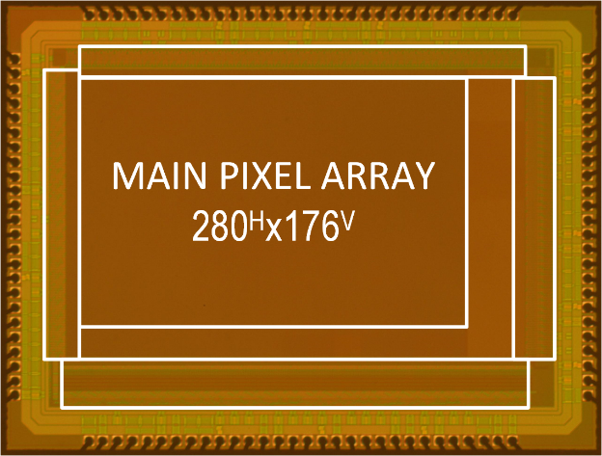
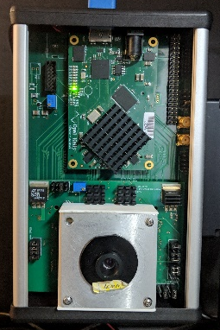
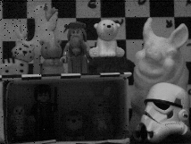
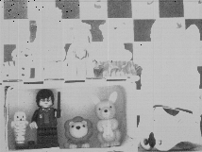
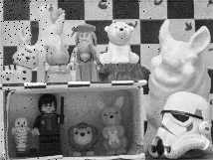
Extending Image Sensor Dynamic Range by Scene-aware Pixelwise-adaptive Coded Exposure
H. Ke, N. Sarhangnejad, R. Gulve,
Z. Xia, N. Gusev, N. Katic,
K. N. Kutulakos, R. Genov
University of Toronto, Toronto, Canada
LDR Mode
HDR Mode
Low Exposure
High Exposure
Per-pixel HDR Exposure
Notes:
Thank you, Mr. X. Today I present our work on increasing the effective dynamic range the camera using scene aware coded exposure.

Slide 2
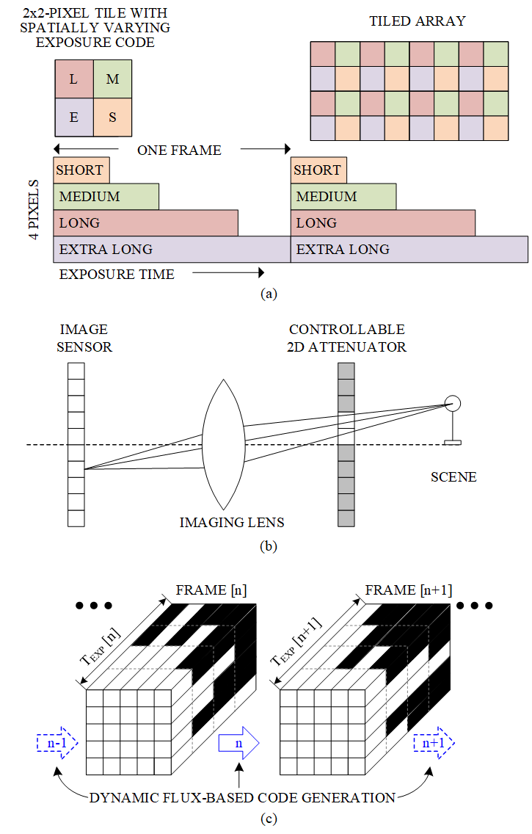
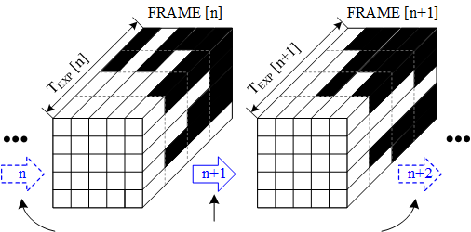
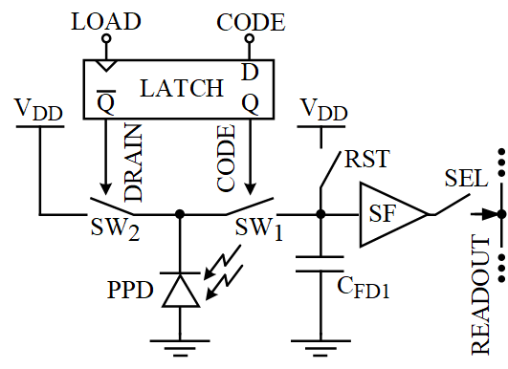
Single-frame HDR Imaging
Existing
Spatially varied exposure
[J. Zhang, US Patent, 2018]
  4 images of different exposure time
  1/4th of the original spatial resolution
Electrically controllable attenuator (SLM)
[S.K. Nayar, ICCV, 2003]
  Per-pixel exposure in optical domain
  Not scalable to high image resolution
Proposed
CODE 0 (OFF)
Dynamic code generation
CODE 1 (ON)
Pixel architecture
Coded-exposure: Binary code sequence directs the photo-generated charges
Scene-aware: Real-time algorithm to generate coding patterns
Notes:
Here we see two techniques which generate HDR images using single frame capture.
The method on the left uses an image sensor with an array of 2x2 pixels tile, which generates 4 images with with different exposure settings. These images are combined to create an HDR image, but the final image resolution is a quarter of the original sensor resolution.
Another method uses a spatial light modulator to adjust the exposure time of the individual pixels, but this method is not scalable to the higher resolutions because it is complex, bulky and distortive
[CLICK]
We propose a technique to capture the high dynamic range images using the scene-aware coded-exposure camera. In the coded-exposure camera, the effective exposure time for the individual pixel can be controlled independently.
In this work we use the scene aware algorithm to generate the coding patterns based on the information from the previous frame.
For example, coding matrix for frame n+1 is generated from the image captured in frame n.

Slide 3
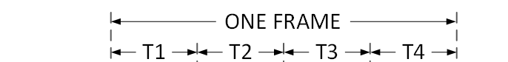
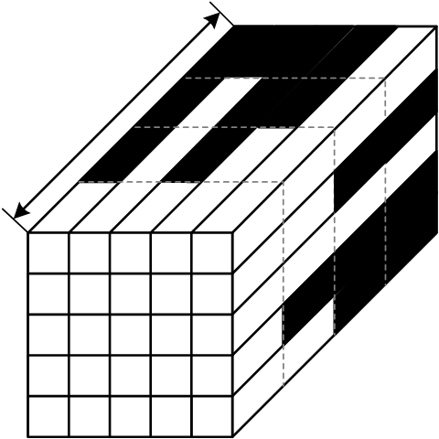
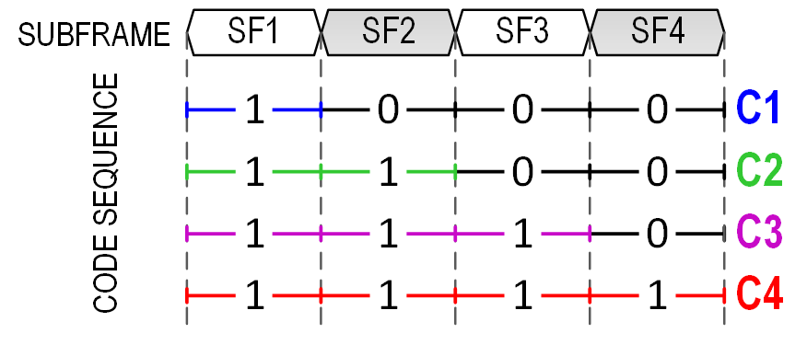
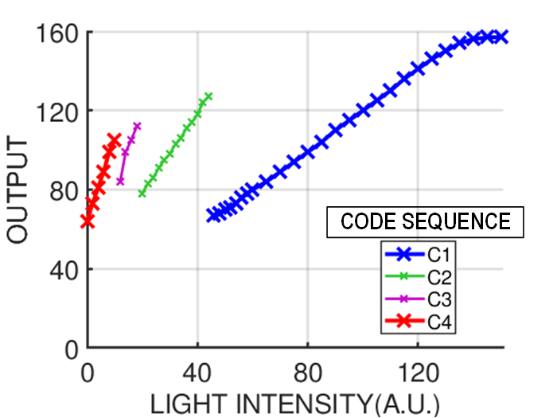
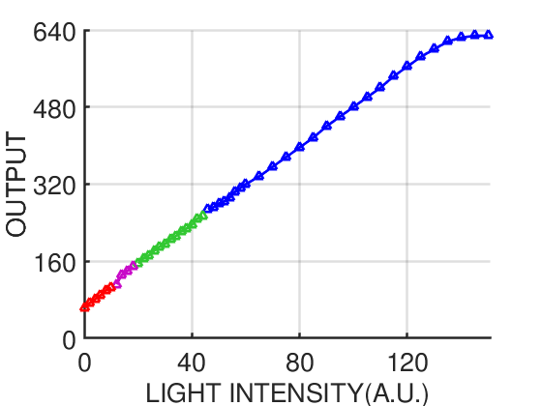
Per-pixel Coded Exposure
CODE 0 (OFF)
CODE 1 (ON)
ONE FRAME
y
time
CODE SEQUENCE
CONVERTED TO EXPOSURE TIME
x
CODE SEQUENCE IN ONE FRAME
LOW LIGHT INTENSITY
HIGH EXPOSURE C4
HIGH LIGHT INTENSITY
LOW EXPOSURE C1
NORMALIZATION
BASED ON
EXPOSURE TIME
SENSOR RAW OUTPUT
HDR RECONSTRUCTION
Notes:
In the coded-exposure camera, an exposure phase in each frame is divided into multiple subframes.
Space-time volume on the right hand side shows how different pixels can have different exposure time based on the code sequence that is applied to them. [CLICK] For example, when code sequence C1 is applied, the pixel are exposed for short period of time and when code sequence C4 is applied pixels are exposed for the full frame.
Different code sequence allows different exposure for each pixel. For example, space-time volume on the right,[CLICK]. Code sequence C1 turns the pixel on only for the first subframe, the pixel is exposed for a short time.And C4 makes the pixel exposed for the full frame.
[Click]
We use THIS ability of the sensor to capture HDR scene. In this graph, the x-axis shows the increasing light intensity the y-axis shows the raw sensor output.
Here we see, code sequence C4 is applied to the pixels capturing dark regions of the scene and code sequence C1 is applied to pixels capturing bright regions of the scene. This makes sure we capture most capture most amount of light while not over-saturating the pixels
[Click]
The sensor output is then normalized based on the exposure time of the individual pixels. After normalization, this increases the effective dynamic range of the sensor.
In this paper, we show two different coding strategies which increase the dynamic range by the factor of 4 or 16.

Slide 4

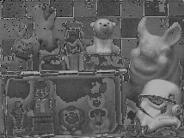
Dynamic Per-Pixel Code Generation
UNIFORM EXPOSURE CODE
INITIAL EXPOSURE
& READOUT
START
CODE GENERATION
CODED EXPOSURE
CODED EXPOSURE CAMERA
READOUT
EXPOSURE CODE
FRAME 0
READOUT
FRAME n
READOUT
HDR
RECONSTRUCTION
FRAME
n = n +1
uP
FRAME n
OUTPUT
HDR OUTPUT
PROCESSOR
RAW OUTPUT
Notes:
Here we will have a look at the scene aware code generation algorithm.
The algorithm starts with initial exposure with a uniform coding matrix
The output of the sensor is similar to output of a conventional camera because .
[Click]
This image is used to generate codes for next frame that decide the exposure time of different pixels.
[Click]
The generated code matrix is uploaded to the coded-exposure camera, and the frame is captured.
[Click]
The raw encoded image is read out from the camera.
[Click]
Then this output is normalized based on the code matrix and exposure time settings that were used to capture this image.
[Click]
After normalization, we get the image with a wide dynamic range.
Common technique such as exposure fusion can be used to present the image on conventional displays.
[Click]
Now, this HDR image is used to refine the masks for the next frame.

Slide 5


HDR vs LDR Experimental Results
LDR MODE
SCENE SETUP
LOW EXPOSURE
HIGH EXPOSURE
PER-PIXEL
EXPOSURE CODES
HDR MODE
EXPOSURE TIME
EXPOSURE TIME
EXPOSURE TIME
RECONSTRCUTED OUTPUT
UNARY WEIGHTED CODES
BINARY WEIGHTED CODES
Notes:
At the top, we see the scene setup using a conventional camera (point to left) and coded-exposure camera in LDR mode (point to right)
[CLICK]
Here, we compare the results of three different coding strategies. The top image shows the exposure time of different pixels and the bottom image shows the captured HDR image.
In this example, the subframes are unary weighted with total exposure high enough to capture the dark scenes, and
[CLICK]
in the second example also the subframes are unary weighted but the unit subframe time is short enough [CLICK] to capture the bright scenes w/o saturating the pixels.
[CLICK]
We propose the binary weighted subframe scheme. In this example, total exposure time is long enough to capture dark scenes and the exposure time for first subframe is short enough to capture the bright scenes.
To conclude, in this paper, we present a method to extend the dynamic range of the image sensor at its native resolution using scene-aware per-pixel-coded exposure.

